Slide 1
Hazelwood v. Kuhlmeier
A First Amendment Case
© Constitutional Rights Foundation. All rights reserved.

Slide 2
This case began at Hazelwood East High School and ended up in the U. S. Supreme Court.
Here are the basic facts of the case:
The school newspaper was written and edited by the Journalism II class at Hazelwood East High School.
Notes:
On slide: The case began… + graphics
Click 1: Here are the basic…
Click 2: The school newspaper… + graphic

Slide 3
Three students in the class worked on a special feature section for the upcoming edition.
Instead of just covering dances and school sports, they wanted to do stories about real problems students at their school dealt with.
New interesting relevant
same old same old
They handed in articles on different topics, including teen pregnancy and students with divorced parents. They interviewed and wrote about students’ experiences. They did not use the students’ real names.
Notes:
On slide: Three of the students… + newspaper graphic + boxes
Click 1: They handed in...

Slide 4
When the school newspaper was ready to go to press, the journalism teacher reviewed it and, as always, gave it to the principal for final review.
The principal directed the newspaper advisor to delete the two pages containing all the feature stories about teen problems.
The principal did not think it was appropriate to run detailed stories about pregnant students. The stories would be read by the whole community, including younger brothers and sisters of students.
Notes:
On slide: When the school… + newspaper graphic
Click 1: The principal… + x graphic
Click 2: The principal did not think it...

Slide 5
He was also worried that even though the names had been changed, people would be able to identify the students interviewed.
He thought that the divorce story was one-sided and did not demonstrate responsible journalism.
Though the principal only objected to the teen pregnancy and divorce stories, he did not think there was time to reformat the paper, so the whole feature section was cut.
Notes:
On slide: He was also worried... + graphic
Click 1: He thought…
Click 2: Though the principal... + graphic
Click to next slide.

Slide 6
The three students believed that their constitutional rights under the 1st Amendment had been violated. They took the school district to court.
The case first went to the federal district court where the court ruled in favor of Hazelwood (the students lost).
Winner
Kuhlmeier, Smart, Tippett (Students)
Hazelwood - School District
The attorneys for the students appealed, and the case went to the U.S. Court of Appeals, where the students won.
Winner
Kuhlmeier, Smart, Tippett (Students)
Hazelwood - School District
Notes:
On slide: The case first…+ graphic
Click 1: Winner graphic
Click 2: The attorneys for the students… + graphics
Elaboration: Ensure that students understand the appeals process the case went through.
Click to next slide.

Slide 7
What arguments did both sides present to the U.S. Court of Appeals?
Attorneys for the Hazelwood District
presented this argument:
The newspaper was part of the school curriculum, and the principal and school board are allowed and expected to control curriculum.
It is up to the teacher, principal, and school board to decide whether students’ articles run in the newspaper. Articles can be censored for reasonable academic concerns.
The principal acted reasonably.
Notes:
On slide: Both sides… + bottom graphic
Attorneys for the Hazelwood...
Click 1: Gavel + The newspaper was…
Click 2: Gavel + It is up to the teacher…
Click 3: Gavel + The principal acted…
Elaboration: Ensure that students understand each argument.
Click to next slide.

Slide 8
Attorneys for Kuhlmeier (the students) presented this argument:
According to school policy, student publications will not restrict free expression…within the rules of responsible journalism and only speech that interferes with the educational environment or invades the rights of others can be prohibited.
The students had a constitutional right to express themselves in the paper.
The principal’s censorship was unreasonable.
Notes:
On slide: Attorneys for Kuhlmeier… + lower graphic
Click 1: Gavel + According to school…
Click 2: Gavel + The students had…
Click 3: Gavel + The principal’s censorship…
Elaboration: Ensure that students understand each argument.
Click to next slide.

Slide 9
Hazelwood school district appealed the case and it went to the U.S. Supreme Court.
The Supreme Court had to decide these questions:
• Can school authorities control the free
expression of ideas in the school newspaper?
• Was the principal’s censorship reasonable?
Notes:
On slide: Hazelwood… + graphic
Click 1: The U.S. Supreme…
Click 2: Can school…(in box)
Elaboration: Ensure that students understand the questions before the court.
Click to next slide.

Slide 10
You are going to take the case to the Supreme Court.
You will take the roles of:
Justices of the U.S. Supreme Court
Attorneys for the Hazelwood School District
Attorneys for Kuhlmeier and the other students
Notes:
On slide: Your are going to take…
Click 1: You will take…
Click 2: Graphic + Justices of…
Click 3: Attorneys for the Hazelwood… + graphic
Click 4: Attorneys for... + graphic
PAUSE to get students into groups.
1. Divide the class into three sections. Assign each section one of the roles:
Justices
Attorneys for Hazelwood
Attorneys for Kuhlmeier
2. Distribute Handout 1 to each student and explain that each group will work together to prepare to present the case of Hazelwood v. Kuhlmeier.
Click to next slide.

Slide 11
To prepare for the case...
Attorneys for Hazelwood: Create arguments to convince the justices that the principal had a right to censor the newspaper and acted reasonably.
Attorneys for Kuhlmeier: Create arguments that the students’ 1st Amendment rights were violated by the principal removing their articles from the paper.
Justices of the U.S. Supreme Court: Create at least three questions to ask each side to help you determine the case.
Decide who will represent your group to perform the moot court.
Notes:
On slide: All text and graphics.
PAUSE to assign tasks:
1. As you present the instructions for each group, ask the students if they have questions.
2. Review the questions before the court and remind students that the case should focus on these issues.
3. Tell the students how much time they have to prepare their arguments and questions. Circulate among the groups and help them prepare.
When the groups are almost finished preparing, click to next slide, then give them three more minutes for final preparation.

Slide 12
Rules for the Oral Argument:
1. Attorneys for Hazelwood will present
first.
2. Attorneys for Kuhlmeier will present
second.
3. Justices will ask questions of both sides during the arguments.
The Justices’ Decision
1. After oral arguments, the justices will meet and discuss the case.
2. Then they will vote.
3. The justices will explain the reasons for the decision.
Notes:
PAUSE to provide final preparation time (3 minutes) and conduct moot courts.
1. After the students have had time to prepare, present the Rules for Oral Argument.
2. Explain that the attorneys for Hazelwood present first because the school district is the party appealing the case from the lower court.
3. Have each side choose two or three people to make its presentation. Give each side a set amount of time for the presentation, e.g. 2 minutes. Don’t count as part of the 2 minutes the time each takes to answer questions from judges.
3. After the oral arguments, ask the justices to discuss, out loud, their thoughts about the case. Explain that this is always done behind closed doors, but that you are interested in hearing their rationale.
4. Ask the justices to take a vote.
5. Ask the rest of the class if they agree or disagree with the decision. Ask students to give reasons why.
After the justices have decided, click to next slide.

Slide 13
Five Steps for Oral Argument and Justices’ Decision
1. Attorneys for Hazelwood, present your arguments.
2. Attorneys for Kuhlmeier, present your arguments.
3. After oral arguments, justices meet and discuss the case.
4. Justices vote.
5. Justices explain your reasons for your decision.
Notes:
PAUSE to provide final preparation time (3 minutes) and conduct moot courts.
1. After the students have had time to prepare, present the Rules for Oral Argument.
2. Explain that the attorneys for Hazelwood present first because the school district is the party appealing the case from the lower court.
3. Have each side choose two or three people to make its presentation. Give each side a set amount of time for the presentation, e.g. 2 minutes. Don’t count as part of the 2 minutes the time each takes to answer questions from judges.
3. After the oral arguments, ask the justices to discuss, out loud, their thoughts about the case. Explain that this is always done behind closed doors, but that you are interested in hearing their rationale.
4. Ask the justices to take a vote.
5. Ask the rest of the class if they agree or disagree with the decision. Ask students to give reasons why.
After the justices have decided, click to next slide.

Slide 14
The Decision of the U.S. Supreme Court in
Hazelwood v. Kuhlmeier (1988)
As the attorneys argued the case, an important question came up...
Is Hazelwood East High School’s newspaper a “Public Forum”?
Public Forum: Streets, parks, or any public facilities which have traditionally been used for the exercise of democracy, including purposes of assembly, communicating thoughts, and discussing public questions.
The 1st Amendment protects free speech in public forums.
This issue became important in the Supreme Court’s decision.
Notes:
On slide: The Decision…
Click 1: As the attorneys argued…
Click 2: Is Hazelwood…
Public forum…
Click 3: The 1st Amendment protects…
This issue became important…
Elaboration: Ask students why they think this might have been an important issue in the Supreme Court’s decision. Ask the students if they think public schools are public forums. Ask them why or why not?
Click to next slide.

Slide 15
The court found in favor of Hazelwood.
Writing the opinion of the court, Justice Byron White said:
Forums for public expression are places like streets and parks…used by citizens for purposes of assembly and discussing public questions. School facilities only become public forums if the school authorities have opened those facilities for indiscriminate use by the public.
Hazelwood never opened up the student newspaper for such indiscriminate use. The production of the newspaper was part of a regular class, not a public forum.
Notes:
On slide: The court found…
Click 1: Writing the opinion…(and rest of decision summary)
Click to next slide.

Slide 16
The decision also says that...
First Amendment rights of students in schools are not exactly like the rights of adults in other settings. A school need not tolerate student speech that is inconsistent with its basic educational mission, even though the government could not censor similar speech outside the school.
Educators do not offend the 1st Amendment by editing or controlling the style and content of student speech in school-sponsored activities (newspapers, plays), so long as their actions are related to educational concerns.
Notes:
On slide: The decision also…
First Amendment rights of students…
Click 1: Educators do not offend…
Ask: Do you agree with this decision? Why or why not?
Click to next slide.

Slide 17
Three of the Justices did not agree with the majority opinion. Justice Brennan wrote the dissenting opinion. He argued:
The 1st Amendment protects student free expression whether or not the forum is school sponsored.
The school newspaper policy allowed for free expression.
The students’ speech did not disrupt classwork or invade the rights of others.
State educators should not be allowed to remove “potentially sensitive” articles.
The principal’s censorship was not reasonable. He could have taken other measures to make the articles more acceptable.
Notes:
On slide: All text.
Ask: Does anyone agree more with the dissent than the majority decision? Why?
How might things be different in schools had the Supreme Court ruled in favor of Kuhlmeier? Do you think things would be better or worse?
Remind the students that Supreme Court decisions become the law of the land, unless the Supreme Court gets a similar case and overturns a past decision. Whatever decisions are made, they must be based on the justices interpretation of the Constitution and Bill of Rights.
Congratulate the students for their participation.

Slide 18
After 1988, the Student Press Law Center helped organize the “New Voices” movement to restore protections of student expression to the pre-Hazelwood standard at the state level.
New Voices laws protect student expression in school-sponsored media, provided that the student expression is NOT:
libelous or slanderous
an invasion of privacy
obscene
a violation state or federal law; or
an incitement of students to materially and substantially disrupt the orderly operation of the school.
Notes:
Tell students: In response to the Hazelwood decision, advocates who disagreed with the decision organized a grassroots campaign to have state legislatures enact laws to restore protections of student expression to the pre-Hazelwood standard.
Click 1: The “New Voices” laws protected student expression as long as it didn’t fall within any of the prohibited categories shown here. Note: these categories are all already prohibited by law: libel and slander; invasion of privacy; obscenity; violations of existing laws; and incitement.

Slide 19
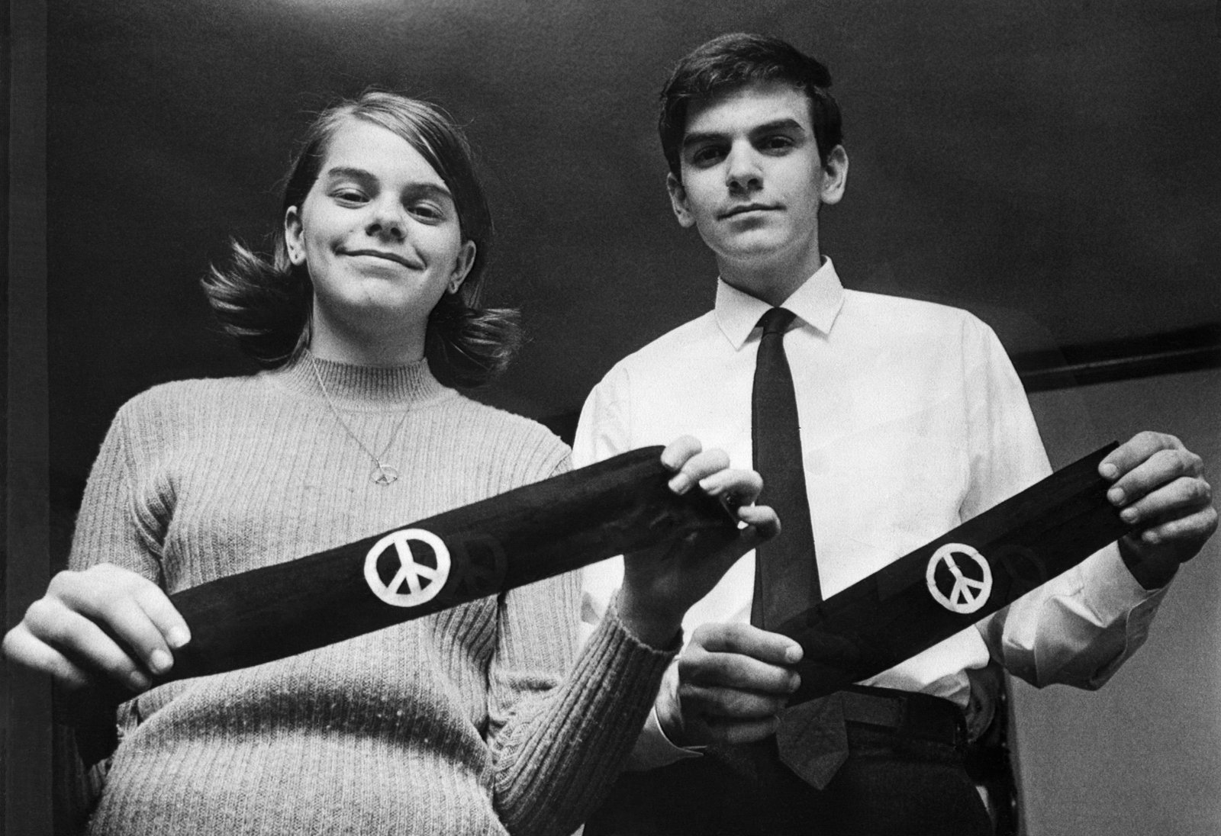
New Voices laws restore the Tinker standard for student expression.
Tinker v. Des Moines (1969)
“A student's rights . . . do not embrace merely the classroom hours. When he is in the cafeteria, or on the playing field, or on the campus during the authorized hours, he may express his opinions, even on controversial subjects . . . if he does so without ‘materially and substantially interfer[ing] with the requirements of appropriate discipline in the operation of the school’ and without colliding with the rights of others.” [Emphasis added.]
“The Constitution says that Congress (and the States) may not abridge the right to free speech. This provision means what it says.”
Notes:
Tell students: The pre-Hazelwood standard comes from the U.S. Supreme Court case of Tinker v. Des Moines from 1969. In that case, John Tinker and his sister Mary Beth, pictured here, and a few others wore peace armbands to school as a form of protest against the Vietnam War.
Their action did not disrupt the school, but it violated a school district policy. They were suspended. When their challenge against the school district reached the U.S. Supreme Court, the court decided (7-2) that the First Amendment applied to minors in schools. Students should be allowed to express their political opinions provided that the expression does not “materially and substantially” interfere with appropriate discipline of the school or violate the rights of other students.
Click 1: The court’s majority was emphatic about the First Amendment applying in schools.

Slide 20
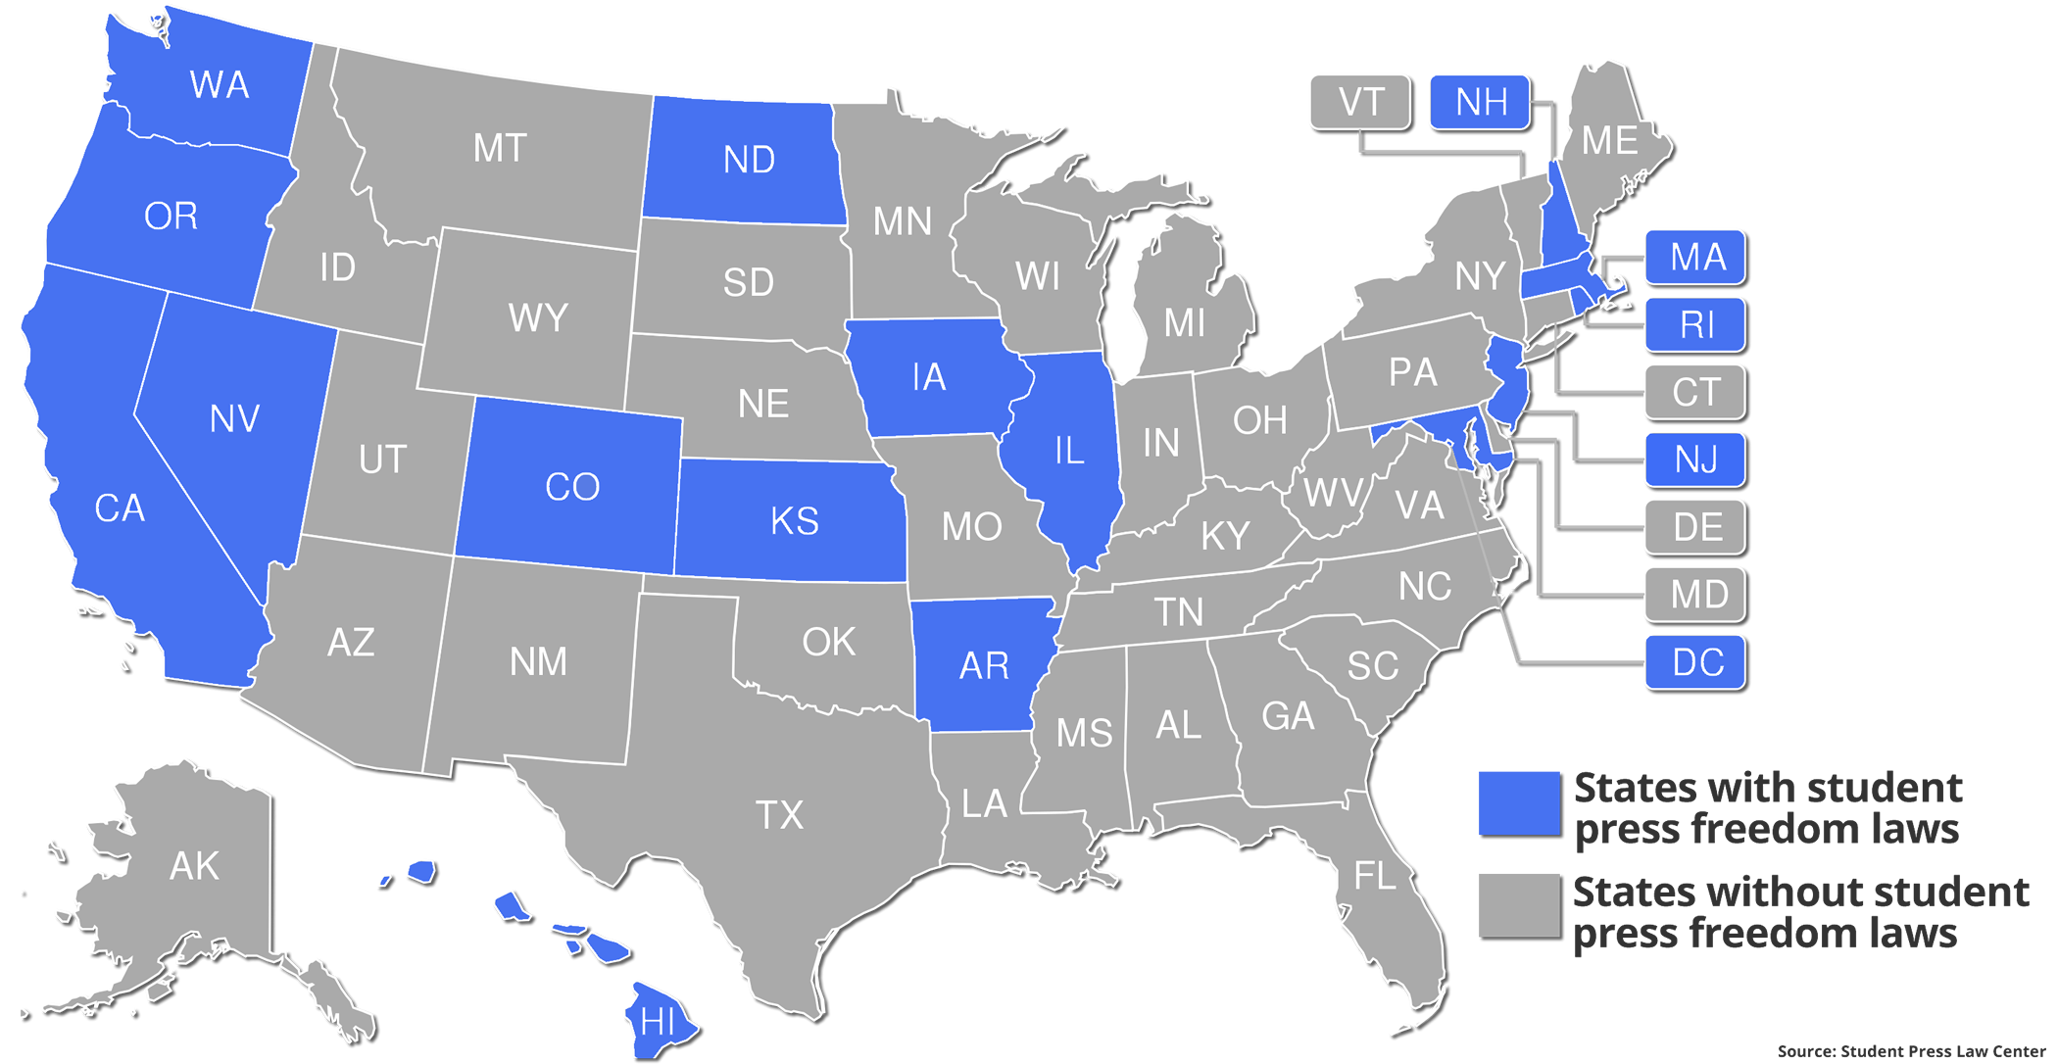
By 2023, 16 states passed New Voices laws . . .
Notes:
Tell students: The states shaded green are states with New Voices laws.
Add: In addition, the state of Virginia has a New Voices law, too, but only for colleges and universities.

Slide 21
The Courts, the Constitution, and the Bill of Rights
Lesson Design: Marshall Croddy
Writers: Keri Doggett & Bill Hayes
Contributing Writer: Damon Huss
Graphic Design: Keri Doggett
Special thanks to Hon. John Kronstadt, CRF Board of Directors, for inspiration and input.
© 2002-2023 Constitutional Rights Foundation, Los Angeles. All rights reserved.

