Slide 1

Kennedy v. Bremerton School District
A First Amendment Case

Slide 2





The First Amendment protects five freedoms:
1. Freedom of
press
2. Freedom of
speech
3. Freedom of
assembly
4. Freedom of
religion
5. Freedom to
petition

Slide 3


The freedom of religion contains two important clauses:
1. The Free Exercise Clause
The free exercise clause prevents the government from placing a burden on anyone’s practice (or free exercise) of their religion, unless the government has a compelling interest in doing so.
2. The Establishment Clause
The establishment clause prevents the government from establishing a religion. This means the government must be neutral on religious matters.
Notes:
Damon

Slide 4
This case is about freedom of speech and freedom of religion.
The name of the case is Kennedy v. Bremerton.

Slide 5
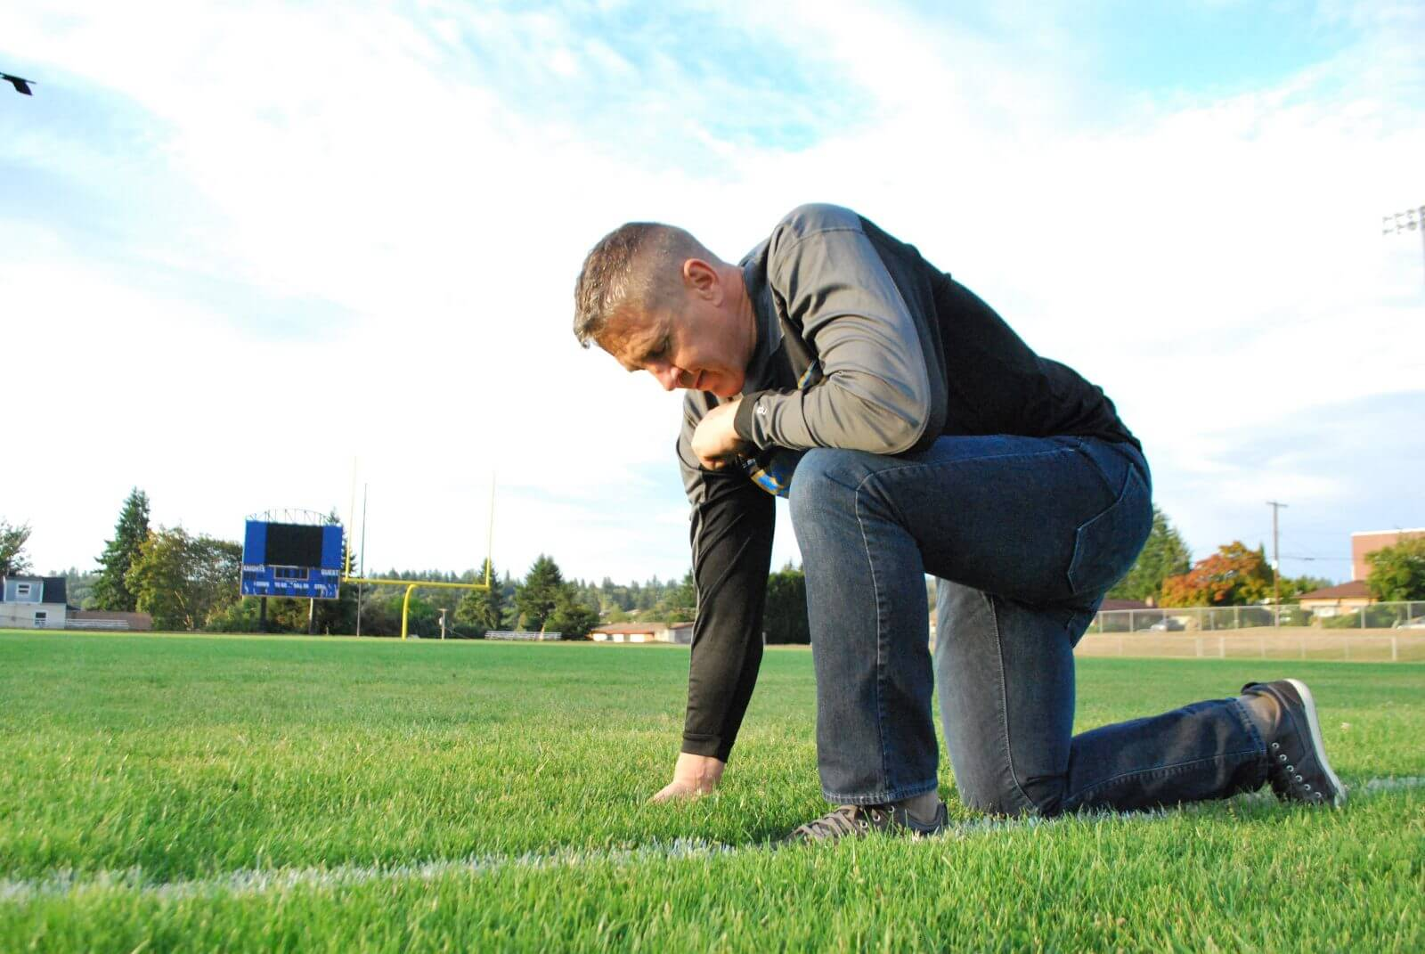
Here are the facts:
Joseph Kennedy, a high school football coach, often gave motivational speeches to his players after games. Sometimes the speeches had religious content.
His employer, the Bremerton School District, warned him that his religious speeches violated the establishment clause under the First Amendment.
Kennedy instead began to kneel at the 50-yard-line and quietly pray by himself for about 30 seconds. Sometimes, players from both teams would join in on the prayers.

Slide 6
The school district feared being sued by some parents for violating the establishment clause.
The school district told Kennedy he could pray, but that his prayers needed to be “nondemonstrative” (so no one could tell he was praying) or out of sight of students.
Notes:
Damon

Slide 7

Kennedy continued his after-game prayers on the football field. The school district placed him on administrative leave.
Kennedy sued the school district. Kennedy argued that the school district’s actions violated the First Amendment’s free speech and free exercise clauses.

Slide 8
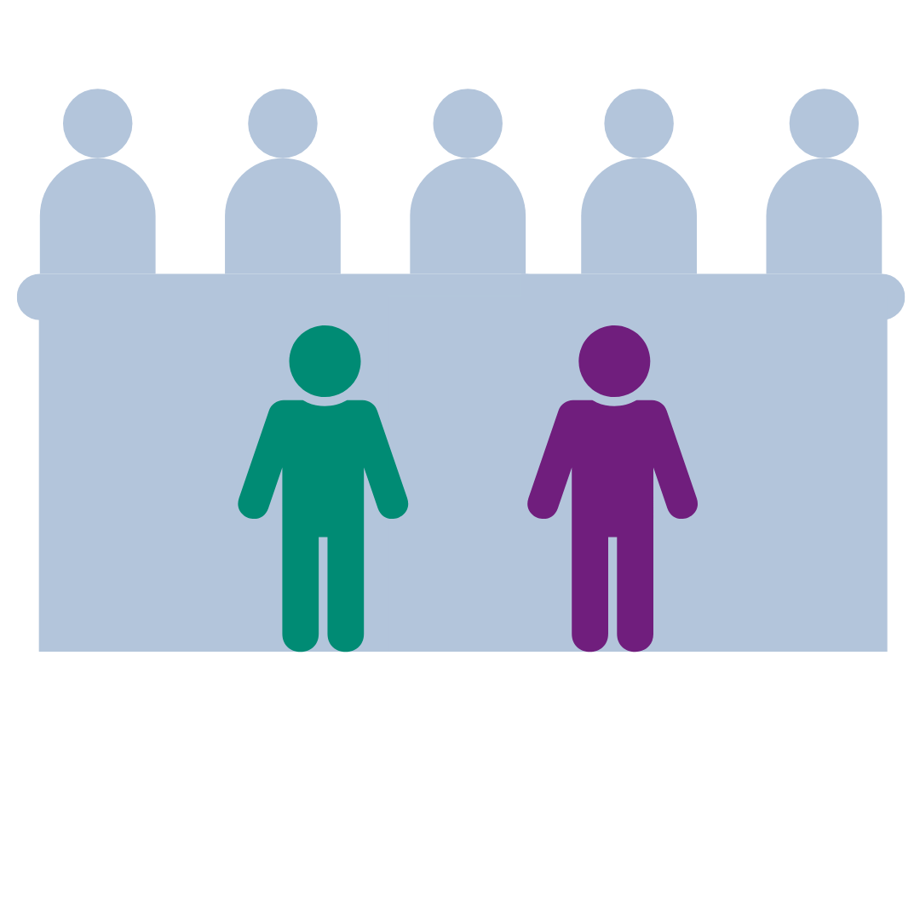

The case then went to the U.S. Court of Appeals, where the court again ruled in favor of the school district (Kennedy lost).
The case first went to the federal district court where the court ruled in favor of the school district (Kennedy lost).
Winner
Winner

Slide 9
What arguments did both sides present to the U.S. Court of Appeals?

Slide 10


Kennedy’s lawyers presented this argument to the appeals court:
Kennedy never demanded that students join him in prayer. The prayers were private speech that is protected by the free-speech and free-exercise clauses.
Kennedy’s quiet, post-game prayers were not government speech just because he was “on duty.” Kennedy did not violate the establishment clause.
The school district wrongfully restricted his private religious practice and should have remained neutral.

Slide 11

Attorneys for the school district presented this argument:
The school district properly restricted his speech because he was on duty at a school-sponsored event when he prayed in front of students. His speech was government speech.
Kennedy’s rights to free speech and to free exercise of religion were not violated because his prayers were not private.
Kennedy’s prayers after games gave the impression that the school endorsed his prayers, violating the establishment clause.

Slide 12
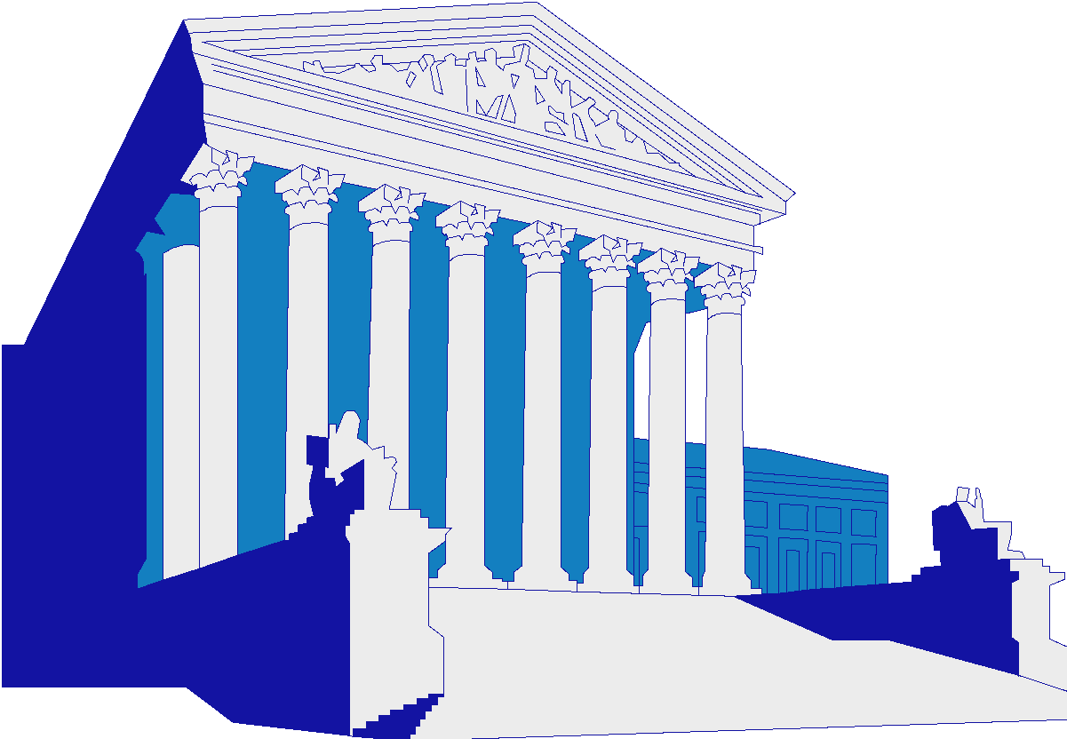
You are going to take the case to the Supreme Court.
The U.S. Supreme Court has to decide this question:
Did the school district violate Kennedy’s rights to free speech and free exercise of his religion when it placed him on leave?

Slide 13



You will take the roles of:
Justices for the
U.S. Supreme Court
Attorneys for the School District
Attorneys for Kennedy

Slide 14
To prepare for the case…
Attorneys for Kennedy: You will argue that the school district violated Kennedy’s rights to free speech and free exercise of his religion. Create arguments to convince the justices that the school district wrongfully restricted Kennedy’s post-game prayer.
Attorneys for the School District: You will argue that the school district did not violate Kennedy’s rights to free speech and free exercise of his religion. Create arguments to convince the justices that the school district rightfully restricted Kennedy’s post-game prayer.
Justices of the U.S. Supreme Court: Create at least three questions to ask each side to help you determine the case.
Decide who will represent your group to perform the moot court.

Slide 15
Rules for the Oral Argument
Attorneys for Kennedy will present first .
Attorneys for the School District will present second.
Justices will ask questions of both sides during the arguments.
The Justice’s Decision
After oral arguments, the justices will meet and discuss the case.
Then, they vote.
The justices will explain the reasons for the decision.

Slide 16
The decision of the U.S. Supreme Court in Kennedy v. Bremerton (2022)

Slide 17
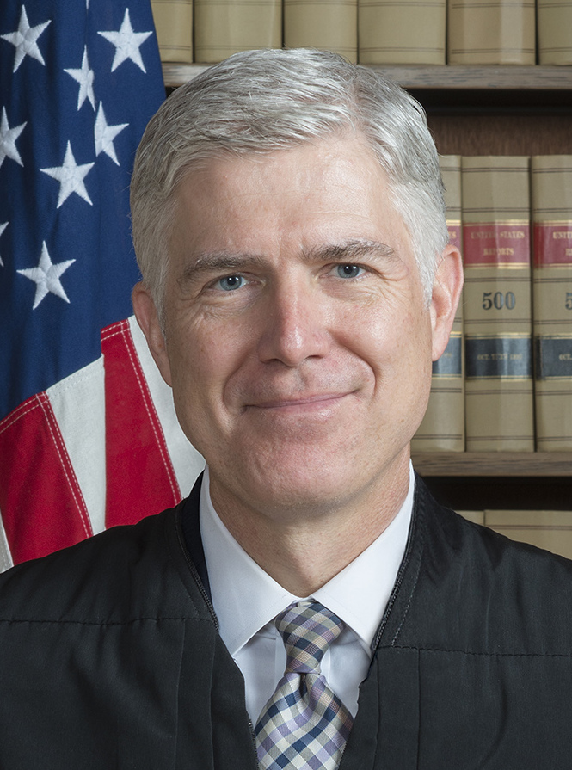
The court found in favor of Kennedy.
Writing the opinion of the court, Justice Gorsuch wrote:
Here, a government entity sought to punish an individual for engaging in a brief, quiet, personal religious observance doubly protected by the Free Exercise and Free Speech Clauses of the First Amendment. And the only meaningful justification the government offered for its reprisal rested on a mistaken view that it had a duty to ferret out and suppress religious observances even as it allows comparable secular speech. The Constitution neither mandates nor tolerates that kind of discrimination.

Slide 18
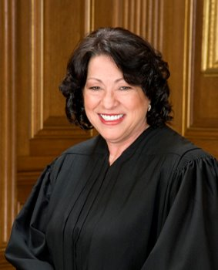
Writing in dissent, Justice Sotomayor wrote:
Today, the Court . . . elevates one individual’s interest in personal religious exercise, in the exact time and place of that individual’s choosing, over society’s interest in protecting the separation between church and state, eroding the protections for religious liberty for all. In doing so, the Court sets us further down a perilous path in forcing States to entangle themselves with religion, with all of our rights hanging in the balance.

Slide 19

Moot Court: Kennedy v. Bremerton
Written by:
Pauline Alarcon
Edited by:
Damon Huss and Keri Doggett
Production:
Kathleen Hughes
© 2024 Teach Democracy
Thanks to board reviewer Kimberly Dunne
For more information about Teach Democracy’s Courtroom to Classroom program, visit https://www.teachdemocracy.org/r/programs/c2c

