Slide 1



Civic Engagement + Writing = Uncommonly Good Idea!
Welcome!
We will be starting soon.

Slide 2


Lucky CRF!
Civic Action Project
Project-Based Learning for Civics
crfcap.org
Lessons that prepare students for CAP projects.
CAP for students:
Identify an issue that matters to you.
Connect your issue to public policy.
Take “civic actions” to make a difference.
What did you do? How did it go?

Slide 3
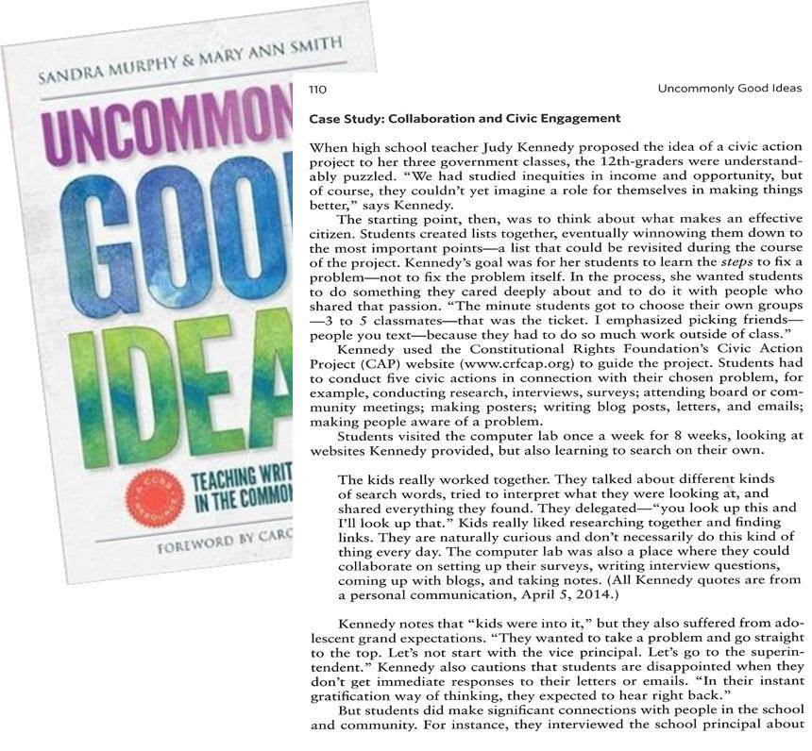
Here we go!

Slide 4
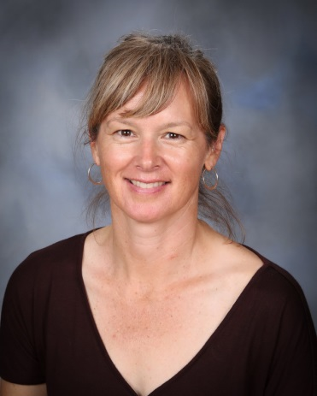


Presenters
Judy Kennedy is in her 14th year of teaching history, economics and government and is embarking on her third CAP project with her students. In addition to working with the Constitutional Rights Foundation, she is a Bay Area Writing Project teacher consultant.
Sandra Murphy, former secondary teacher, is professor emerita at the University of California, Davis. She served as a work group member to develop the Common Core State Standards.
Mary Ann Smith, former secondary teacher, directed the Bay Area and California Writing Projects and served as Director of Government Relations and Public Affairs for the National Writing Project.

Slide 5
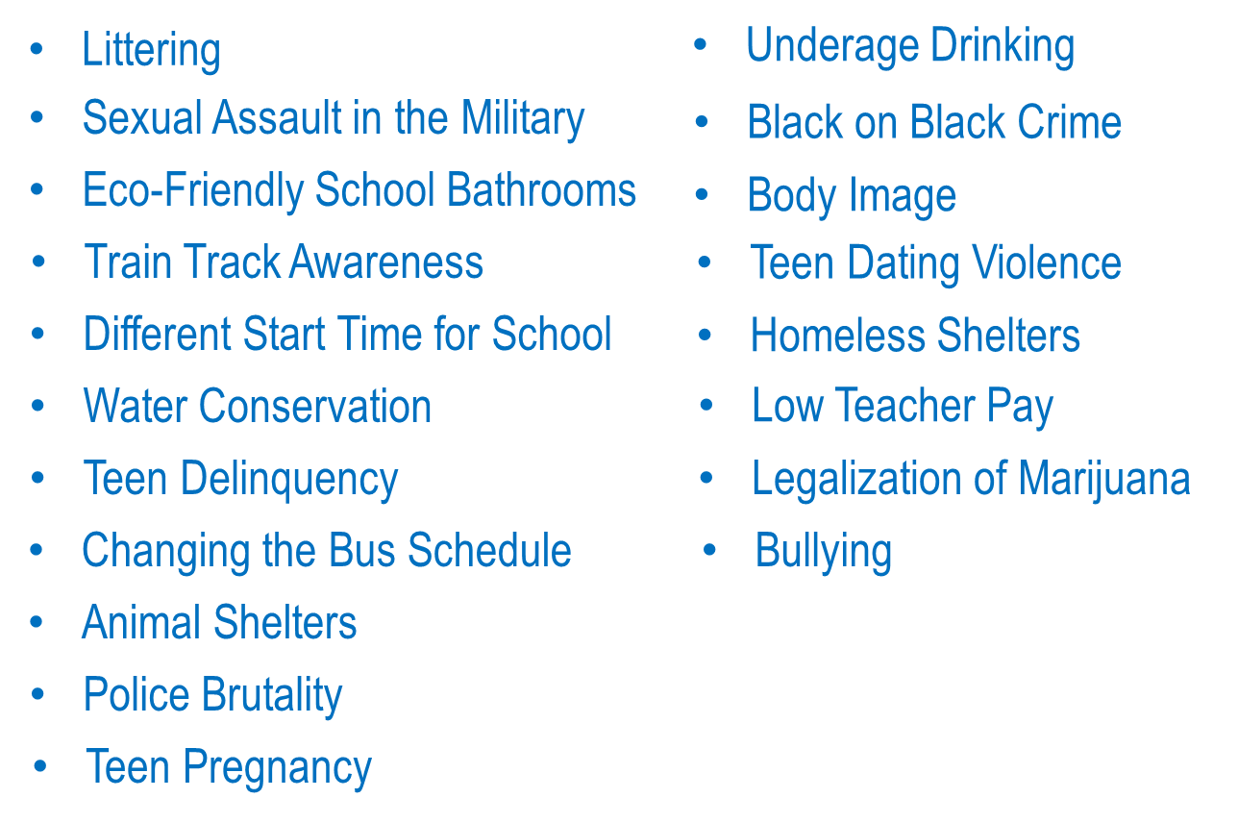
CAP Topics

Slide 6
Poll Question!

Slide 7
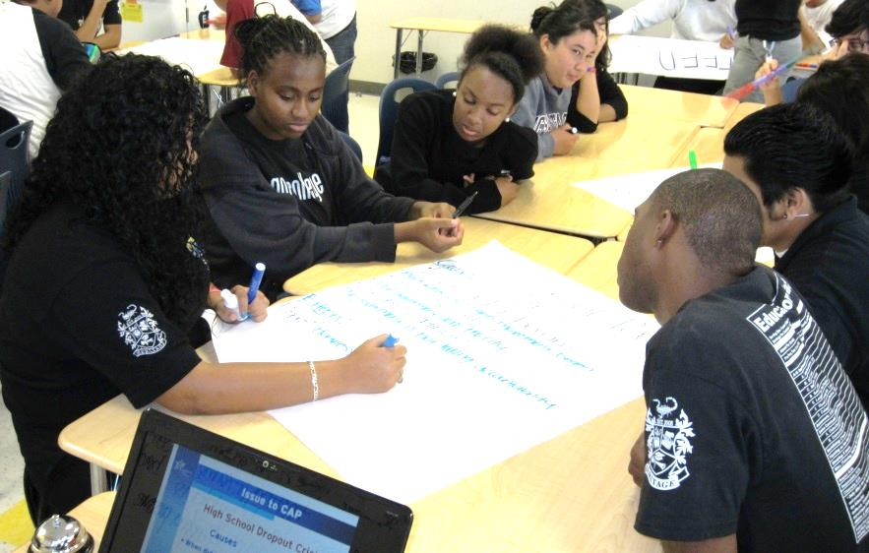
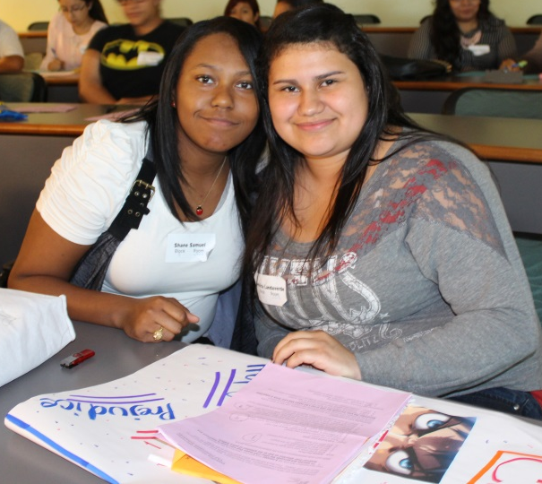
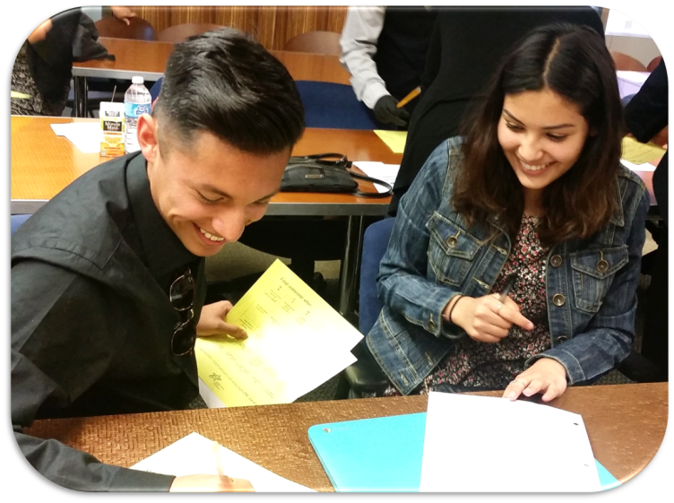
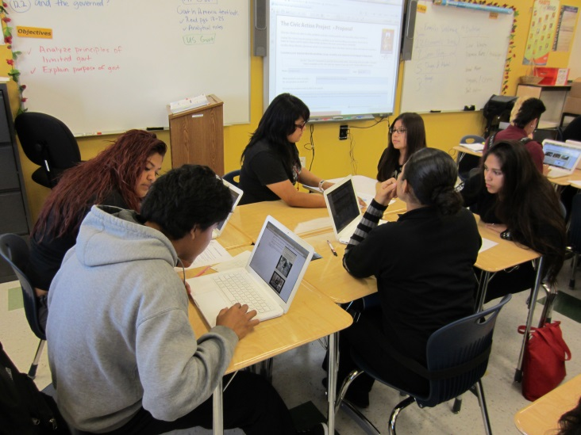
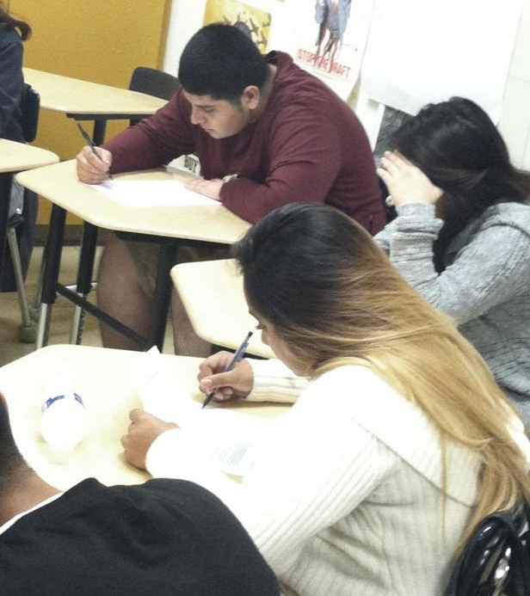
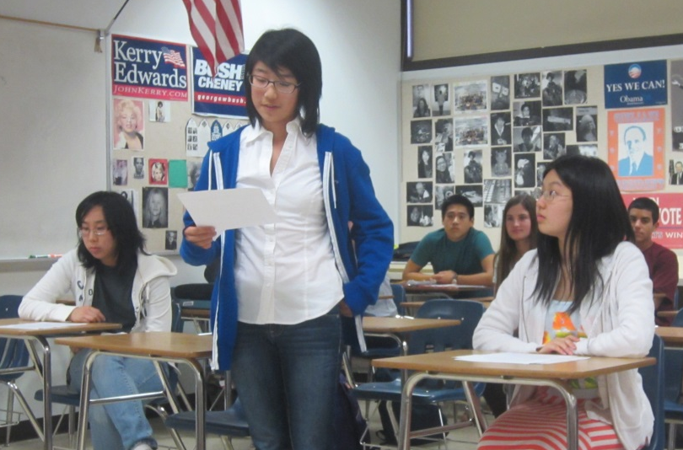

Slide 8
Our Purposes
To look at all the writing opportunities in the CAP project.
To discuss how CAP fits with the Common Core State Standards.
To talk together about some student writing samples & videos.

Slide 9
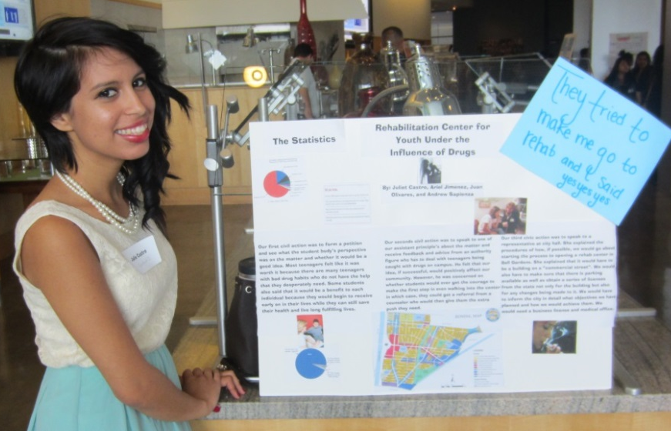
Opportunities for writing in CAP
Analysis
Goal setting/gathering evidence
Interview and survey questions
Email requests for interviews and/or information
Petitions
Letters to elected officials
Reflection
Final Report
Note taking/note making
Scripts and storyboards for PSAs & multimedia presentations
Did we miss anything?

Slide 10
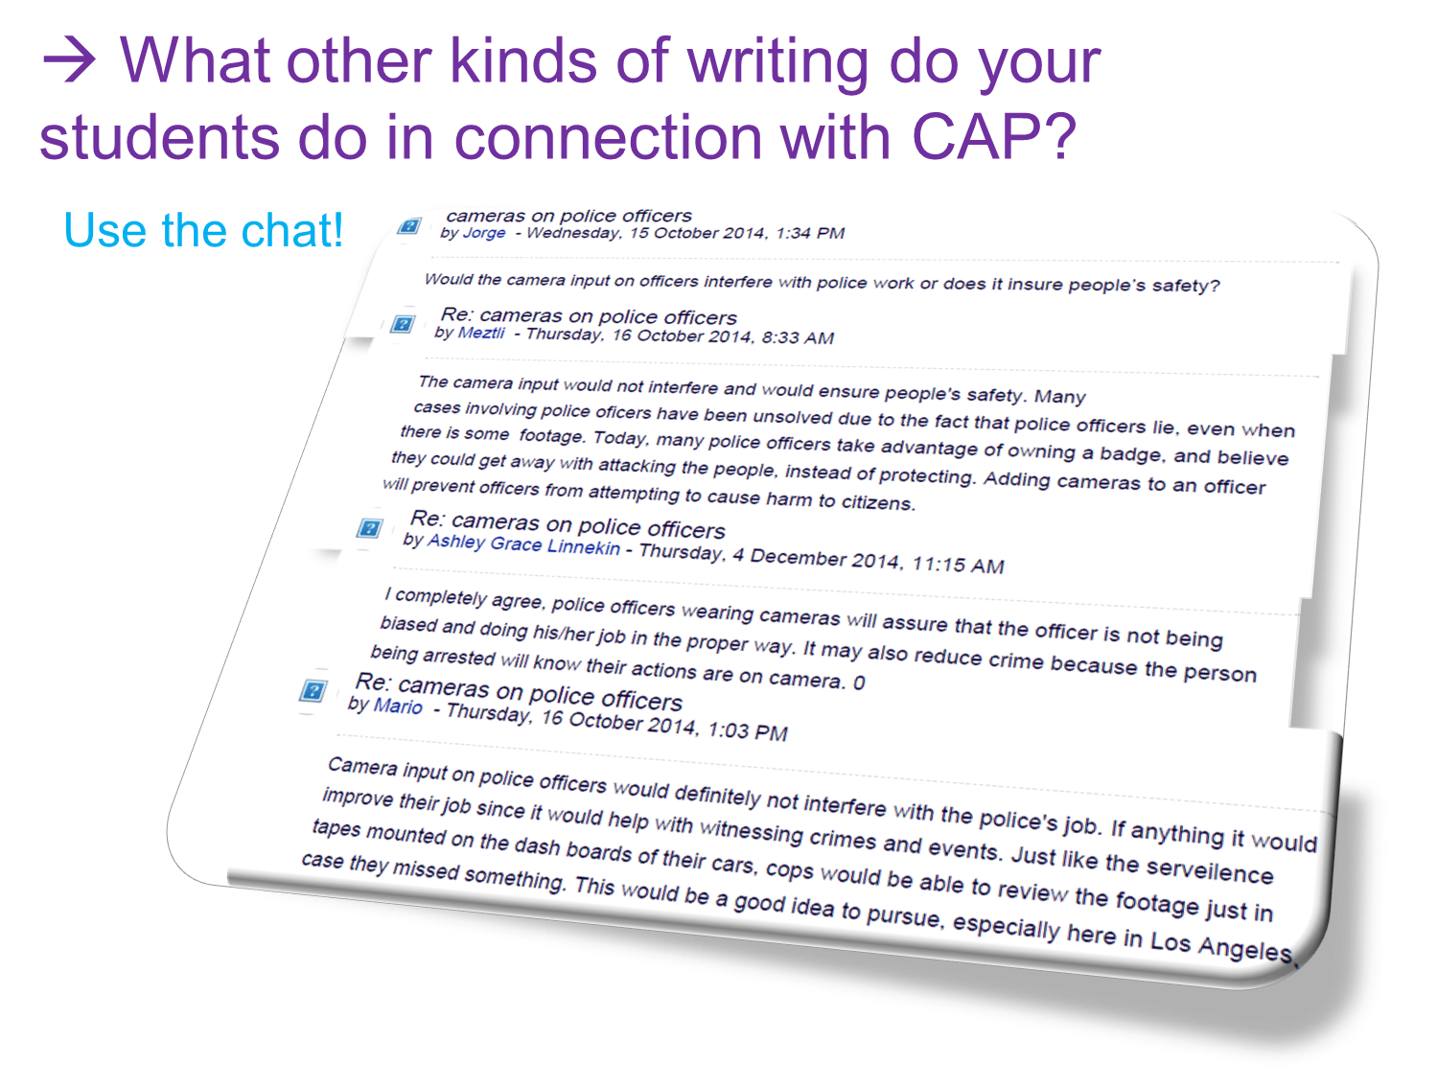

Slide 11
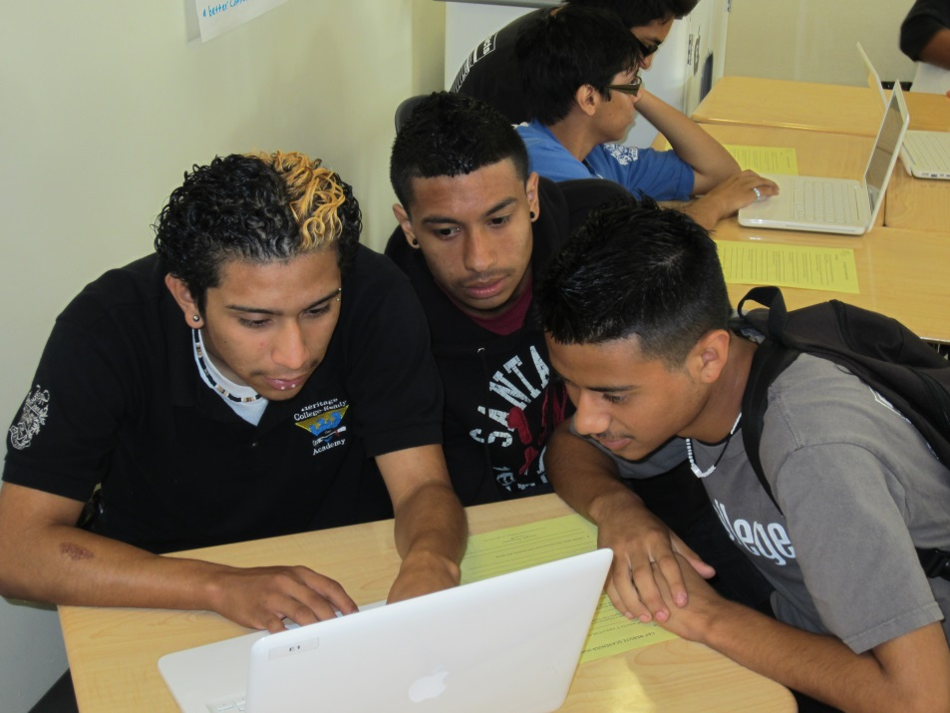
What do we mean by a range of writing?
Many kinds of writing.
Writing for different purposes and audiences.
Varying time frames for writing.
Writing individually and writing with the benefit of collaborating.
Using technology as
a tool for writing.

Slide 12
There’s a story behind every CAP project.
The issue that I worked on is train track safety. I wanted to make the people more aware of the dangers of walking on the train tracks. I chose to talk about train track safety because I feel the problem of people walking on the train tracks only gets brought up when somebody dies. I feel like we need to discuss train track safety as a community and take action now to prevent the number of deaths from happening. Another reason I chose to work on train track safety is because one of my friends ended up dying from playing on the train tracks. When my friend Austin Price got struck by an Amtrak train, I was devastated. When he died, I felt like I really didn't do anything to contribute towards his death. When I received the chance to do a project on anything I wanted to do, I figured why not do train track safety. So, I'm spreading awareness about the dangers of walking on the train tracks and making a tribute to Austin's death at the same time.

Slide 13
Everything doesn’t have to be an essay!
The topic of teen depression and suicide is very important because it affects many people on a daily basis. It's a mental disease that slowly takes over people's lives and can lead to self-harm or even suicide. It has become like a common thing amongst teens which is not okay. Depression also has an impact on education because sometimes that disorder doesn't allow teens to think and focus properly in school. Teen depression and suicide are an epidemic. This is a topic I am really passionate about because I've had my own experiences with it and I know how bad it can get. Teens with depression need help. Depression can't be ignored. The percentage of depression amongst teens is too high and needs to be lowered.

Slide 14
More student writing
Skating in Gym Class by Barend U. St Joseph MO
I know skating in gym class may not be an urgent issue with the stock markets falling and the war in Iraq, but please consider these suggestions to the curriculum of physical education in American schools. Imagine, if skateboarding were offered in gym class, there would be so many new skills students could learn, like agility, stamina, and balance. I think that skateboarding is a great sport and needs to be included in the physical education curriculum. If you were to learn how to skate, you would have to push a lot, which mimics running, and also if you run a lot, you have more stamina and of course, you need balance just to ride a skateboard. According to Skateboard America, skateboarding is the sixth ranked sport in popularity. Kids like it because they think it looks cool, not all kids have the time to be on a team, or just because it feels great to ride. So why isn't it offered in gym class? The goal of gym class is to teach adolescents a healthy lifestyle by offering them many sports to try and skating falls under that list perfectly. By giving students a chance to skate, it may show them a new activity to enjoy and stay healthy by doing it. There are over 300 skate parks in America, and it would be easy for schools and students to access them. If a school does not have a skate park nearby, any paved parking lot would work just as well.
Skating has taught me to be brave and has given me more energy and strength, has taught me to be much more stable than before, has kept me healthy, and I have had a lot of fun doing it...This isn't an urgent measure.

Slide 15
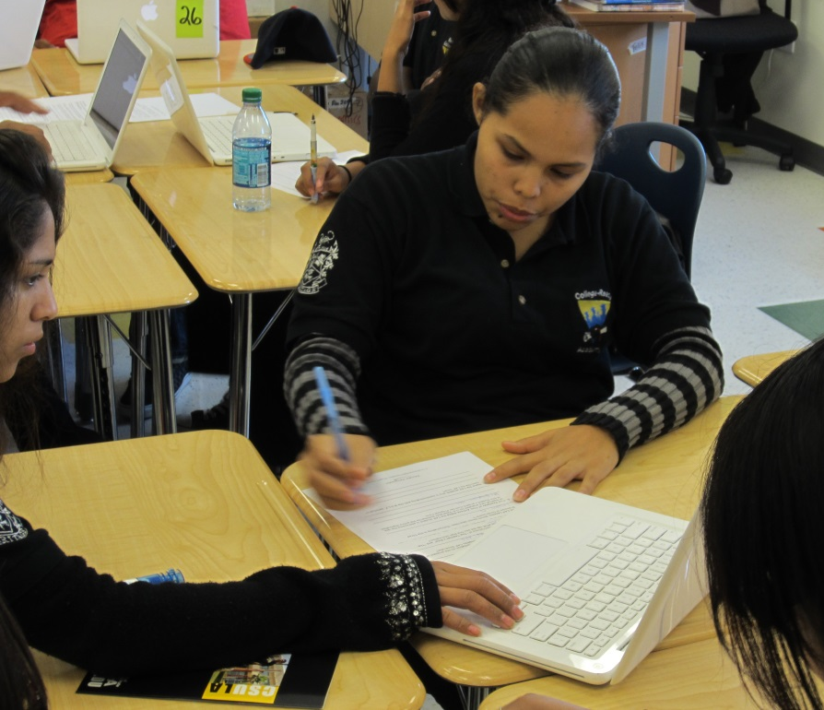
A typical reading/writing day during a CAP project.
Collaboration
Compilation and Analysis
Checking In
Writing

Slide 16
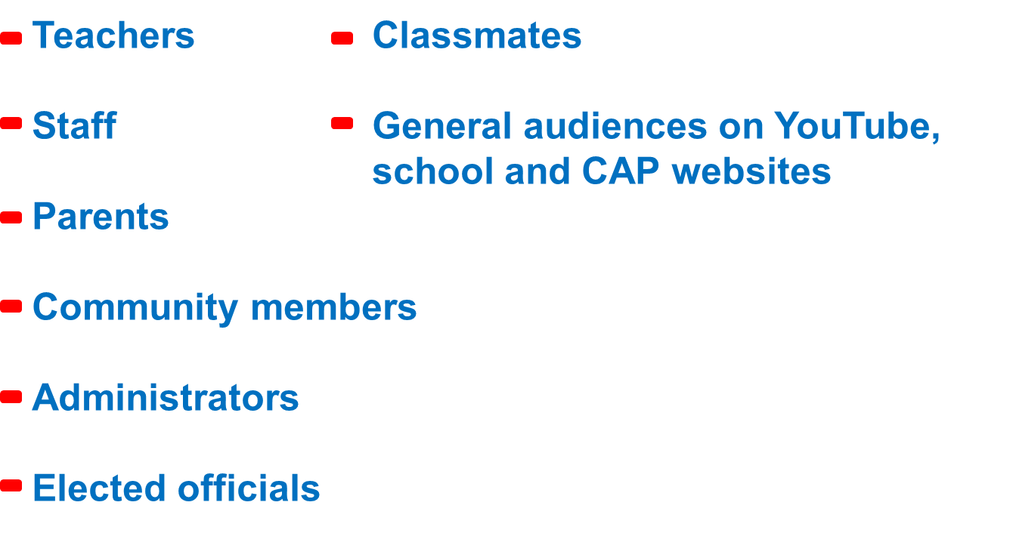
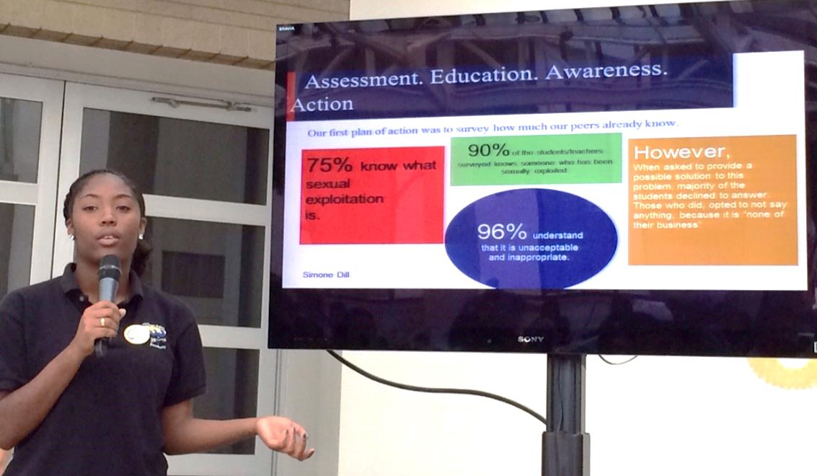
Reaching varied audiences through CAP

Slide 17
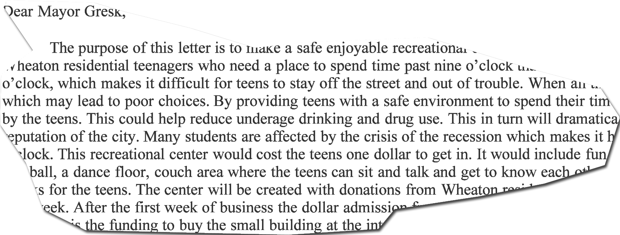
What other audiences do your students write for?
Use the chat!

Slide 18
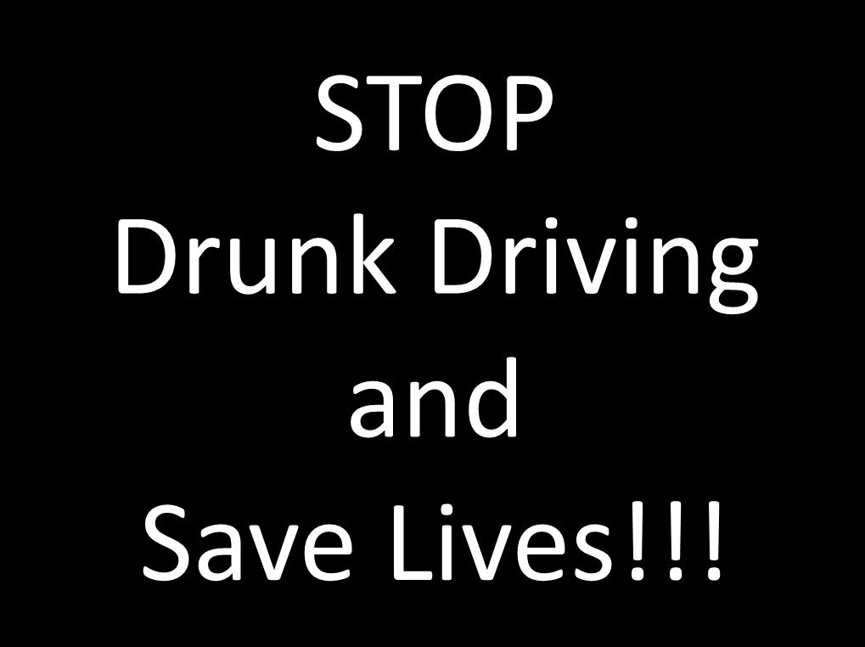
Student Work: CAP PSA

Slide 19
Analyzing a PSA
Claims
Evidence
Call To Action
What difference do a “real” audience and purpose make?
(Use the chat!)

Slide 20
Reflective writing – students get the last word
Some skills that I gained after this experience were open-mindedness; I now know not everyone is going to feel the same way as I do. I also learned how to communicate well with others, and how to be more professional with the things I say or do. I also gained a voice; I know now that I’m not the only one who wants to be heard. There are many people who want change just as bad as I do. My attitude changed dramatically throughout this experience. At first I thought that no one really cares and no one was going to give us the time of day, but now I know that I was completely wrong. People do actually care, and do want to hear what we have to say. By doing little things like these civic actions, I do believe that it is possible to make change in our society.

Slide 21


Thank you for joining us!
Do you have more questions or some CAP writing you want to share?
keri@crf-usa.org
20 of you will receive Uncommonly Good Ideas!
We’ll send a link to the survey.
Up Next: You CAN Make Teaching From Primary Sources Exciting
When: Thursday, October 22, 2015 from 4:30pm to 5:30pm PACIFIC TIME
Where: Online

