Slide 1
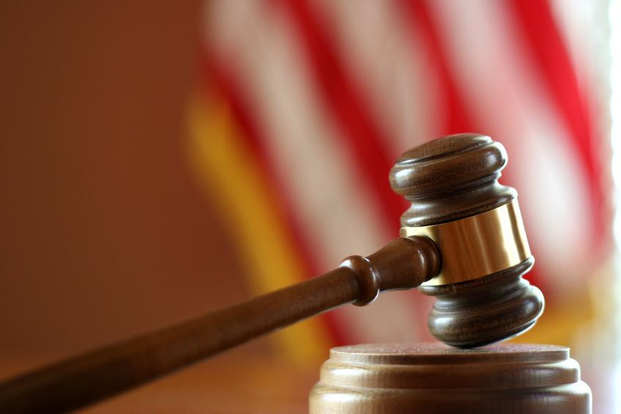
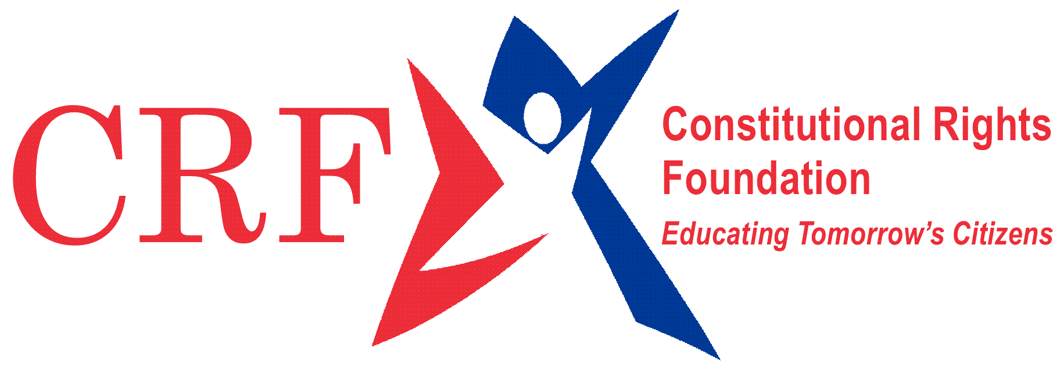
From the Courtroom to the Classroom
Chicago v. Morales
© 2006 Constitutional Rights Foundation, Los Angeles, CA
All rights reserved.

Slide 2
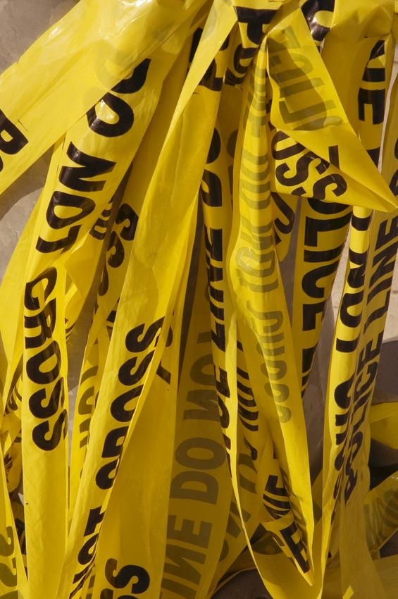
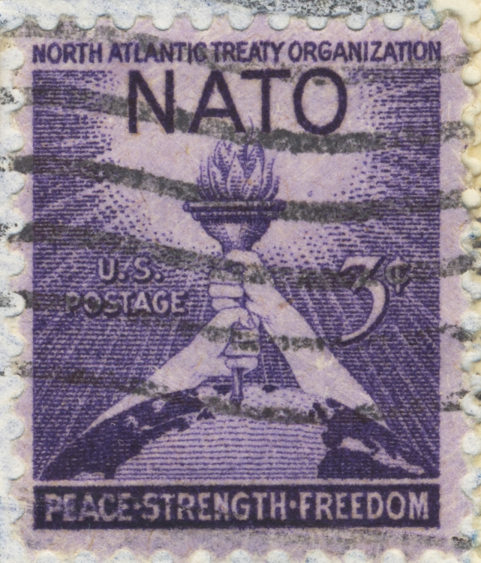
This year, you are learning about the role of government in making laws.
Laws do many things. From…
helping the economy,
to protecting the well-being of citizens,
to organizing the United States’ relationships with other nations.

Slide 3
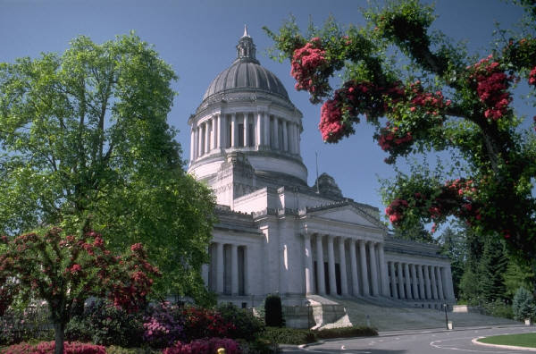
Who makes laws?
Laws in our country can be enacted by Congress, state legislatures, and even local governing bodies. For example, many public school districts have their own governing body called a school board. It makes the rules for their schools.
Notes:
What are some rules a School Board may enact?

Slide 4
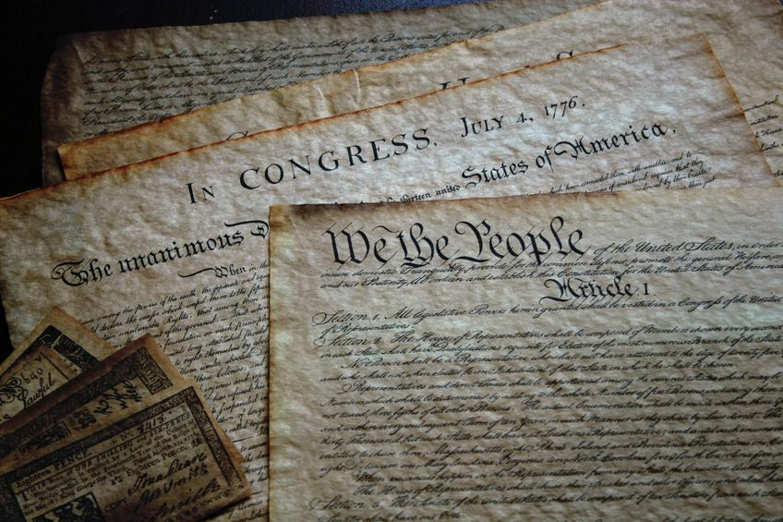
All laws are subject to limits set in the Constitution and the Bill of Rights.

Slide 5
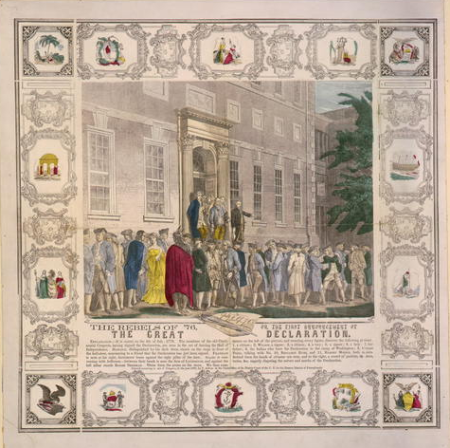
The Constitution and the Bill of Rights were written more than 200 years ago. Our country had gained its independence from the English crown.
To make sure Americans never again suffered from the tyranny of a monarchy, where all power resided in one person, the nation’s founders set up a system of checks and balances.

Slide 6
Three Branches of Government
The Constitution divides the powers of government among three branches:
The executive (the president)
The legislature (Congress)
The judiciary (the Supreme Court)
Each branch serves as a check and balance on the others.

Slide 7
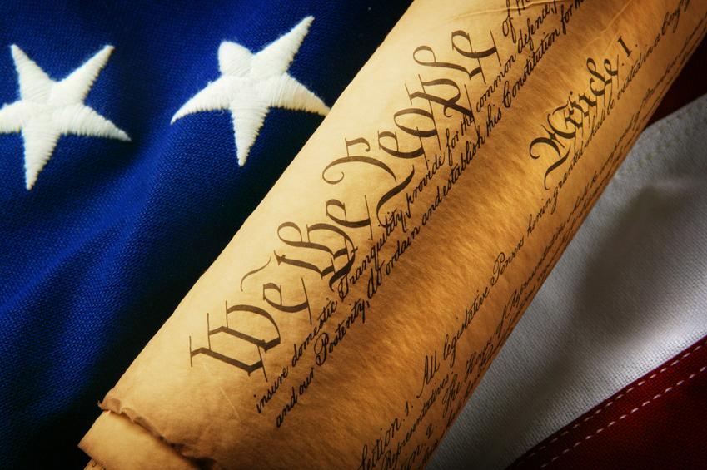
Federal versus State Power
The Constitution gives the federal government express powers. All other powers are reserved for state governments.
Further, the Constitution protects the liberties and rights of citizens from government intrusions.
Notes:
Can someone give an example of a federal law? A state law?
Can someone give an example of an individual right?

Slide 8
Individual Rights
For example, the First Amendment gives individuals the freedom to speak, to associate with others, and to practice the religion of their choice.
That means, for example, that the Constitution bans the government from passing a law requiring every citizen to practice the same religion.

Slide 9
These Rights Are Not Absolute
As citizens we have a right to speak freely. But there are limits to our free speech rights. For example, we do not have a right to falsely scream “Fire!” in a crowded movie theater.
In that case, the right to speak freely is outweighed by the interest of the government in public safety.
Not all cases are that clear.
The job of balancing the needs and concerns of the government with the rights of individuals outlined in the Constitution and the Bill of Rights falls to our nation’s courts.

Slide 10
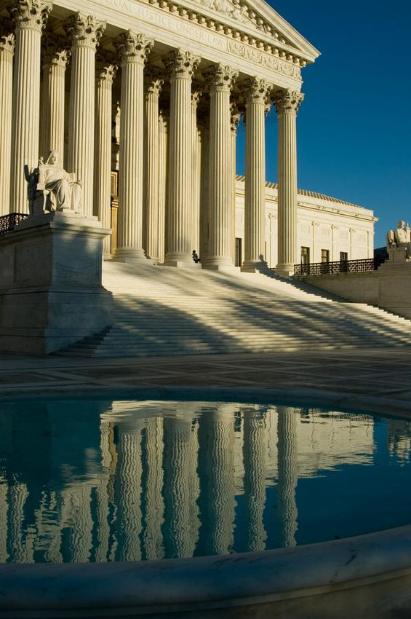
We have two court systems– state and federal.
State courts decide issues of state law.
Federal courts consider federal claims and often decide federal constitutional issues.
The highest federal court is the U.S. Supreme Court. It has the last word on interpreting the Constitution and Bill of Rights.
Today, you are going to have an opportunity to interact in a real case argued before the Supreme Court. You get the chance to argue on one side of the case or to decide the outcome as a Supreme Court justice.

Slide 11
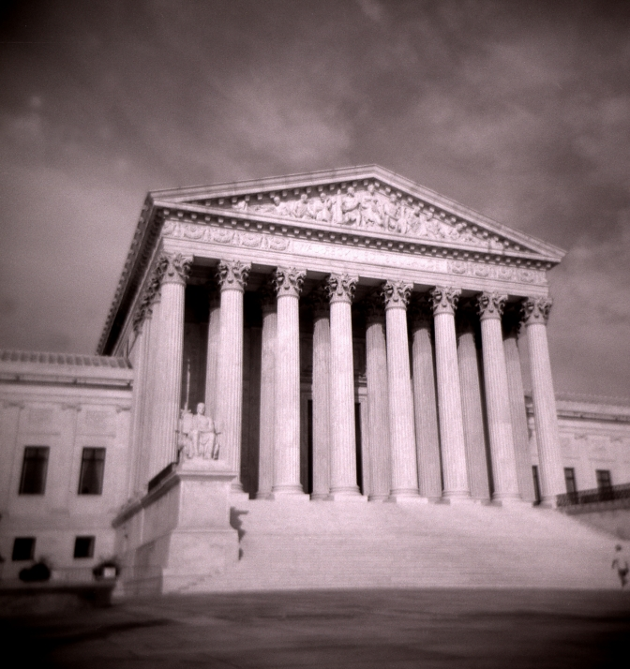
CHICAGO v. MORALES
A U. S. Supreme Court Case
© Constitutional Rights Foundation, Los Angeles, 2006. All rights reserved.

Slide 12
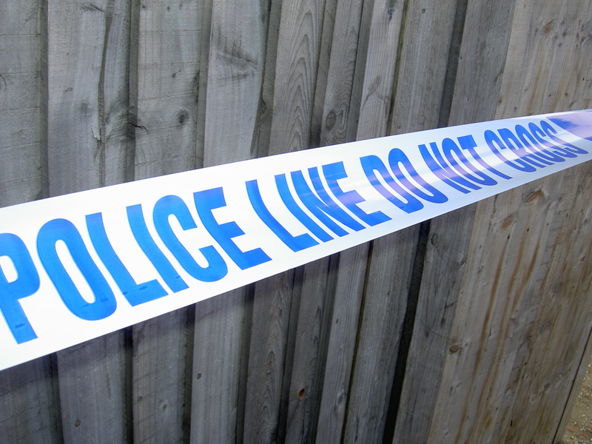
Facts of the Case
The Chicago City Council voted to enact a “Gang Congregation Ordinance.” It banned known “criminal street gang members” from “loitering” with one another or other persons in any public place.
The law’s purpose was to lower the crime rate and make neighborhoods safe. It specifically aimed to reduce gang-related violence and homicides and drug trafficking.

Slide 13
The ordinance stated:
Whenever a police officer observes a person whom he reasonably believes to be a criminal street gang member loitering in any public place with one or more other persons, he shall order all such persons to disperse and remove themselves from the area. Any person who does not promptly obey such an order is in violation of this section.

Slide 14
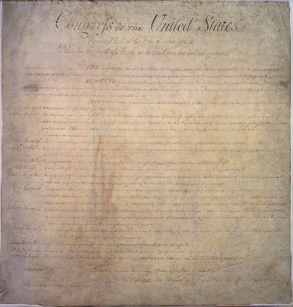
Under the ordinance, a person could only be arrested for not complying with an order from the police to disperse. During the three years the law was enforced, 42,000 people were arrested for violating the ordinance.
Some of these people challenged the law. They claimed it was unconstitutional because it violated their First Amendment rights to congregate.
?
?
?
They also argued that the law was vague because a reasonable person reading the law would not know what activity could be punished.
?
?
The trial court found the law unconstitutional, and the city of Chicago appealed the decision to a higher court..

Slide 15
Attorneys for the city of Chicago presented these arguments:
The ordinance is necessary to reduce crime in Chicago. The court should defer to the City Council, which conducted extensive hearings on gang-related crime.
The First Amendment does not protect “loitering,” which is defined as “to remain in any one place with no apparent purpose.”
The ordinance limits police discretion. The officer must reasonably believe that a loiterer belongs to a criminal street gang. An officer may not issue a dispersal order to anyone moving along or who has an apparent purpose.
The ordinance is not vague. People may only be arrested if they fail to comply with a dispersal order.

Slide 16
The lawyers for Morales presented these arguments:
The freedom to loiter for innocent purposes is a liberty protected by the Constitution. The law intrudes on the rights of non-gang members to assemble.
The language of the law is vague. It fails to give citizens notice of how not to violate the law. “Loitering” is not defined. It could include completely innocent activity.
The law gives police too much discretion, which has led to arbitrary and even discriminatory enforcement. The law allows the police to judge whether a person is a gang member and whether such persons are “loitering.”

Slide 17
The case went through the appeals process.
So the City of Chicago appealed the case to the U.S. Supreme Court.
This court also ruled in favor of Morales.
Winner
The city then appealed to the Illinois Supreme Court.
This court ruled in favor of Morales.
Winner
Winner
First, it went to the Illinois Court of Appeals.

Slide 18
You are going to take the case to the Supreme Court.
The court must decide whether Chicago’s Gang Congregation Ordinance violates citizens’ constitutional rights.
You will take the roles of:
1. Attorneys for the City of Chicago, who argue that the law is constitutional.
2. Attorneys for the people who were arrested, who believe the law violates their constitutional rights.
3. Supreme Court justices, who must decide whether the law is constitutional.

Slide 19
To prepare for the case:
Justices: Think of at least three questions for each side that will help you decide the case.
Attorneys: Prepare arguments to present to the justices. Decide who will present your arguments and who will answer questions.
Rules of Oral Argument
1. Attorneys for Chicago will present first.
2. Attorneys for Morales will present second.
3. Justices will ask questions of both sides during the arguments.

Slide 20
The Decision of the Court
A majority of the nine justices agreed to strike down the Chicago gang law. Their main reasons were:
The law failed to give notice to ordinary citizens of what they could and could not do legally.
The law failed to give guidance to police officers as to what citizens they should be arresting. Without this guidance, police officers would have too much power to decide who to arrest.
The law prohibited some conduct that many people would consider innocent.

Slide 21
Dissenting Opinions
Three justices dissented and would find the law acceptable. They reasoned that communities have a right to pass laws to address local problems such as gang activity even if it means some residents have to give up some of their freedoms.
One justice emphasized that all laws restrict some freedom:
“The citizens of Chicago were once free to drive about the city at whatever speed they wished. At some point [they] decided this would not do, and imposed speed limits designed to assure safe operation by the average driver . . . . This infringed upon the ‘freedom’ of all citizens, but was not unconstitutional.” 527 US at 52.

Slide 22
For Discussion…
Who do you think was right?
How many of you changed your minds about the law after arguing the case?
Was it difficult to argue for a side you did not believe in?
How would you feel about this law in your community?

Slide 23
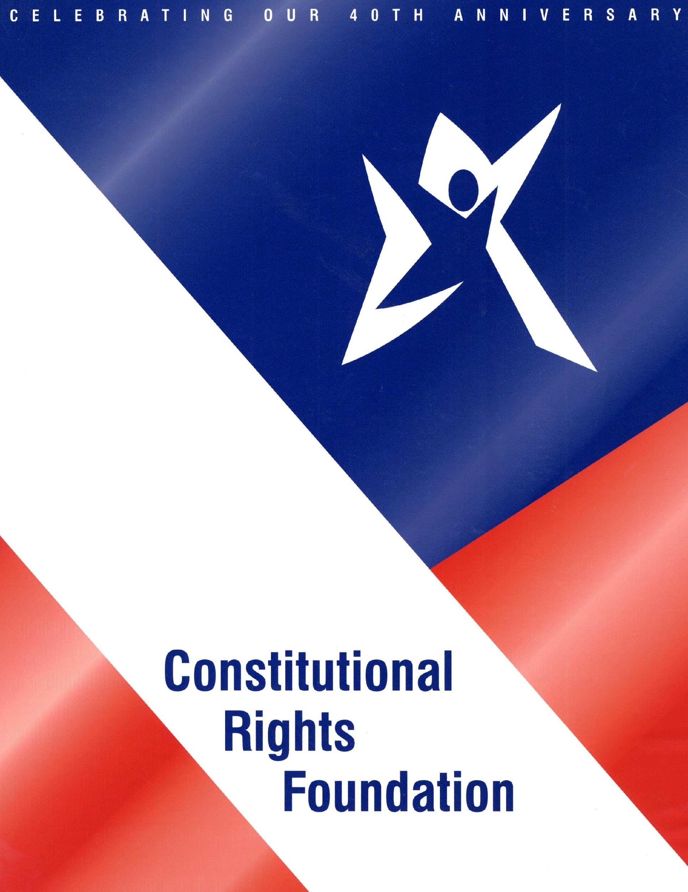
From the Courtroom to the Classroom: Chicago v. Morales
Developed by Marshall Croddy
Written by Kalpana Srinivasan, Alexandra Susman, and Keri Doggett
Graphic Design and Production by Keri Doggett
Special thanks to John Kronstadt, member of CRF Board of Directors, for inspiration and input.
© 2006 Constitutional Rights Foundation, Los Angeles. All rights reserved..

