Slide 1
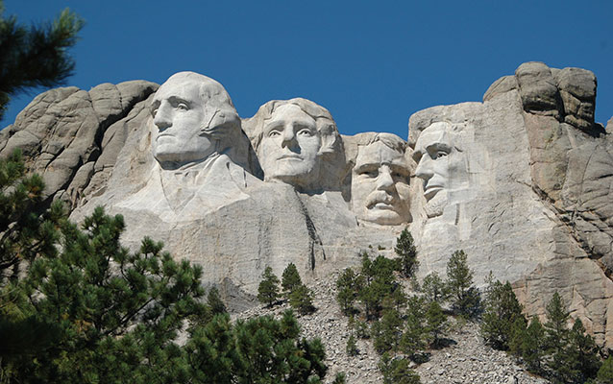
Mount Rushmore National Memorial
Keystone, South Dakota
National Park Service

Slide 2
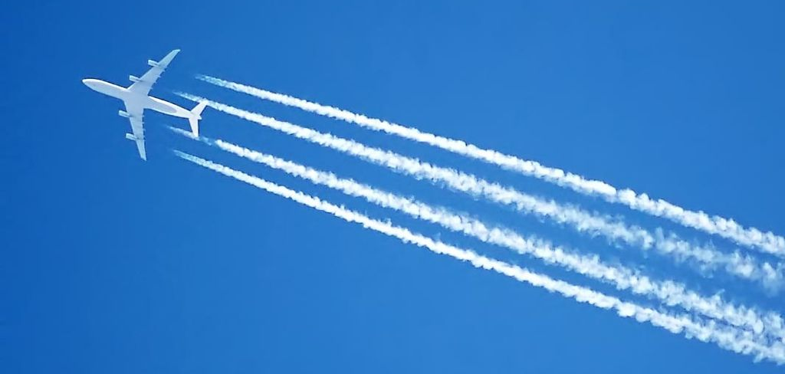
The contrails of an Airbus A340 jet, over London, England. (Wikimedia Commons)
Writing & Discussion
Have you heard or read about any of the stories mentioned in the article (for example, “chemtrails”)? If so, what were your sources? How trustworthy do you consider those sources to be?
What is a logical fallacy? Cite at least three mentioned in the article in your answer.
Notes:
See the lesson plan for guidelines for the teacher.

Slide 3
What logical fallacies, if any, did you find in John Krebs’s claims?
Here are the fallacies discussed in the article:
  1) anecdotal evidence
  2) cherry-picking data
  3) false cause
  4) the slippery slope
  5) begging the question
  6) personal incredulity
Notes:
See the lesson plan for guidelines for the teacher.

