Slide 1
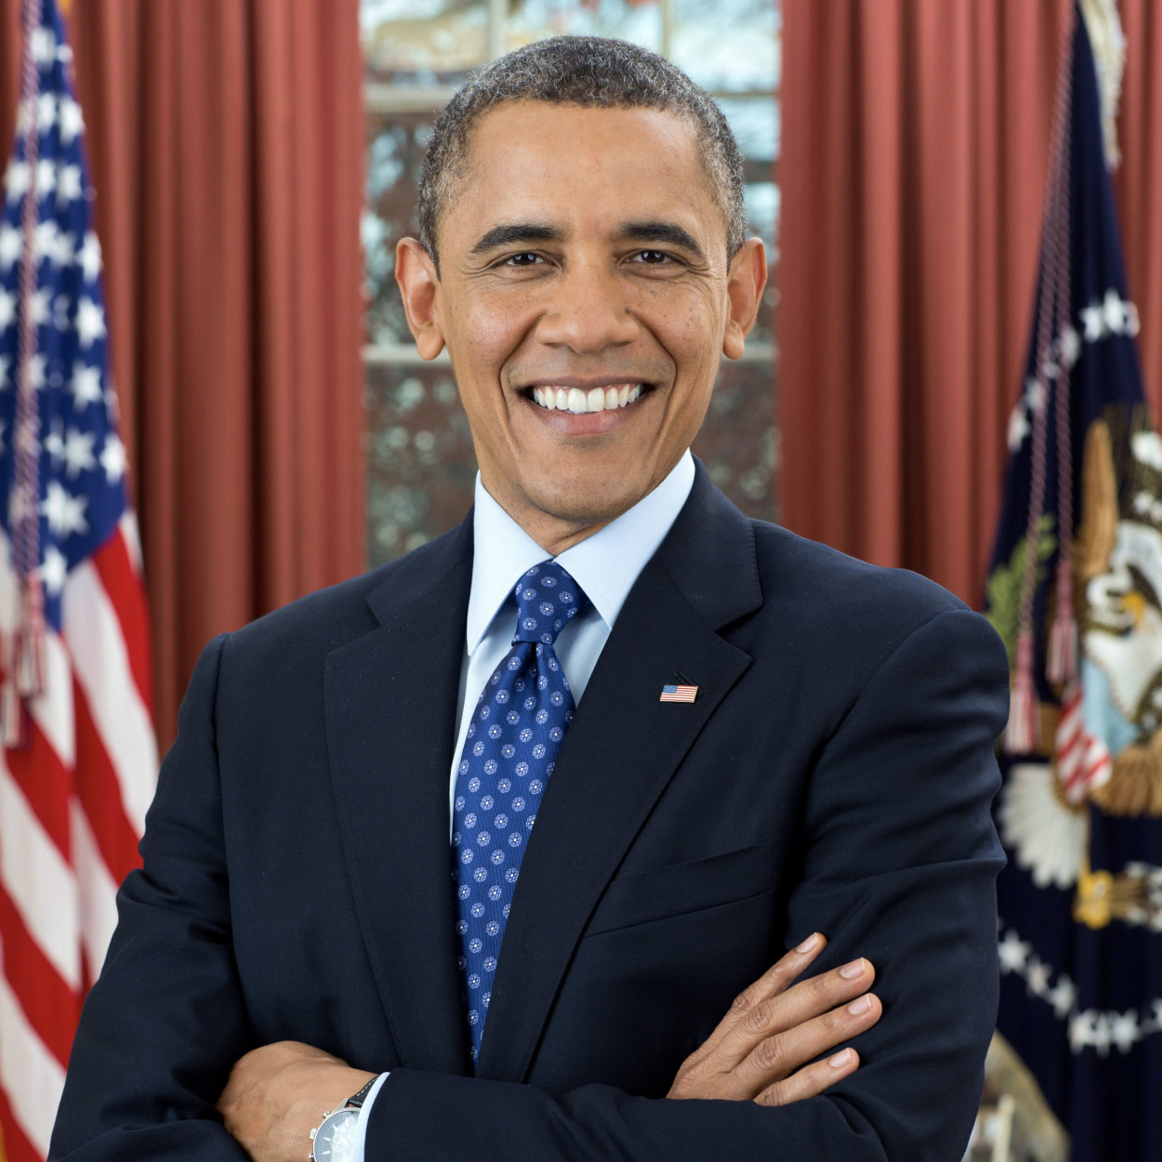



Barack Obama:
The United States of America’s
First Black President
Grades K-2
© 2021, Constitutional Rights Foundation and Los Angeles County Office of Education

Slide 2
Barack Obama: The U.S.A.’s First Black President (Grades K-2)
Teacher Instructions
This lesson for grades kindergarten through two tells a story about President Barack Obama using PowerPoint slides. Each slide provides a simple activity you can do with your students as a whole class, or students who are good readers and PowerPoint pros can lead the activity. The last slide contains a link to a video of the Obamas’ dogs “saying goodbye” from the White House (just for fun!).
This lesson supports the California History-Social Science Framework and Standards for Grades K-2:
• Historical Thinking: Students examine photos, decide which photos fit with the story, make a timeline, and sort captions.
• Civic Learning: President, elections, inaugurations, civic dispositions (hope, making a difference).
• History: First Black president, Vice President Biden becoming President Biden.
• Families: Diversity of families, values, things families do together.
This lesson complies with California Assembly Bill 1912 to require instruction on the historical significance of President Obama as the first African American president. The bill was introduced by California Assemblymember Chris Holden and signed into law in 2014. http://www.leginfo.ca.gov/pub/13-14/bill/asm/ab_1901-1950/ab_1912_bill_20140825_chaptered.pdf
Tips for using the PowerPoint:
• You or your students will need to manipulate the photos, captions, etc., so do not use “Presentation” or “Slide Show” view.
• The ribbon can be collapsed by hitting the caret “^” in the upper right of your screen to provide more screen for the slides.
• If you choose to show the video at the end, note that there may be advertisements, so check for age-appropriateness. Hover on the photo for the link or paste in browser.
Optional Discussion Questions:
• What things did Obama do that helped him become president?
• Obama was the 44th president. Why do you think it took so long for the U.S.A. to have a Black president?
• What kinds of things do the Obamas do together? What kinds of things does your family to together?
• What do you think presidents of the United States should care about? What should they do?
• Barack Obama was the first Black person to be president or vice president, which are nationally elected offices (elected across all 50 states). Who was the next Black person to hold nationally elected office? (Kamala Harris, elected vice president in 2020)
© 2021, Constitutional Rights Foundation and Los Angeles County Office of Education

Slide 3
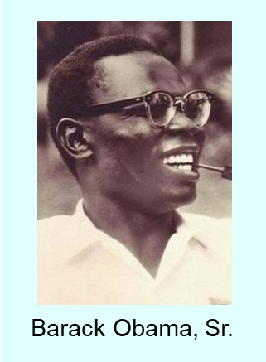
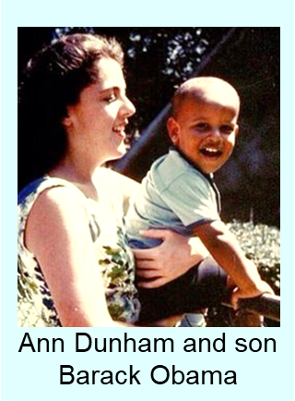
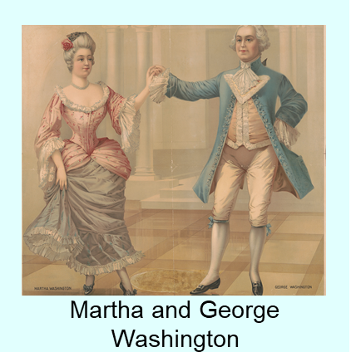
Barack Obama was born on August 4, 1961 in Hawaii.
Which image does not belong? Delete it!
© 2021, Constitutional Rights Foundation and Los Angeles County Office of Education

Slide 4
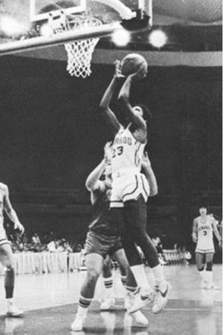
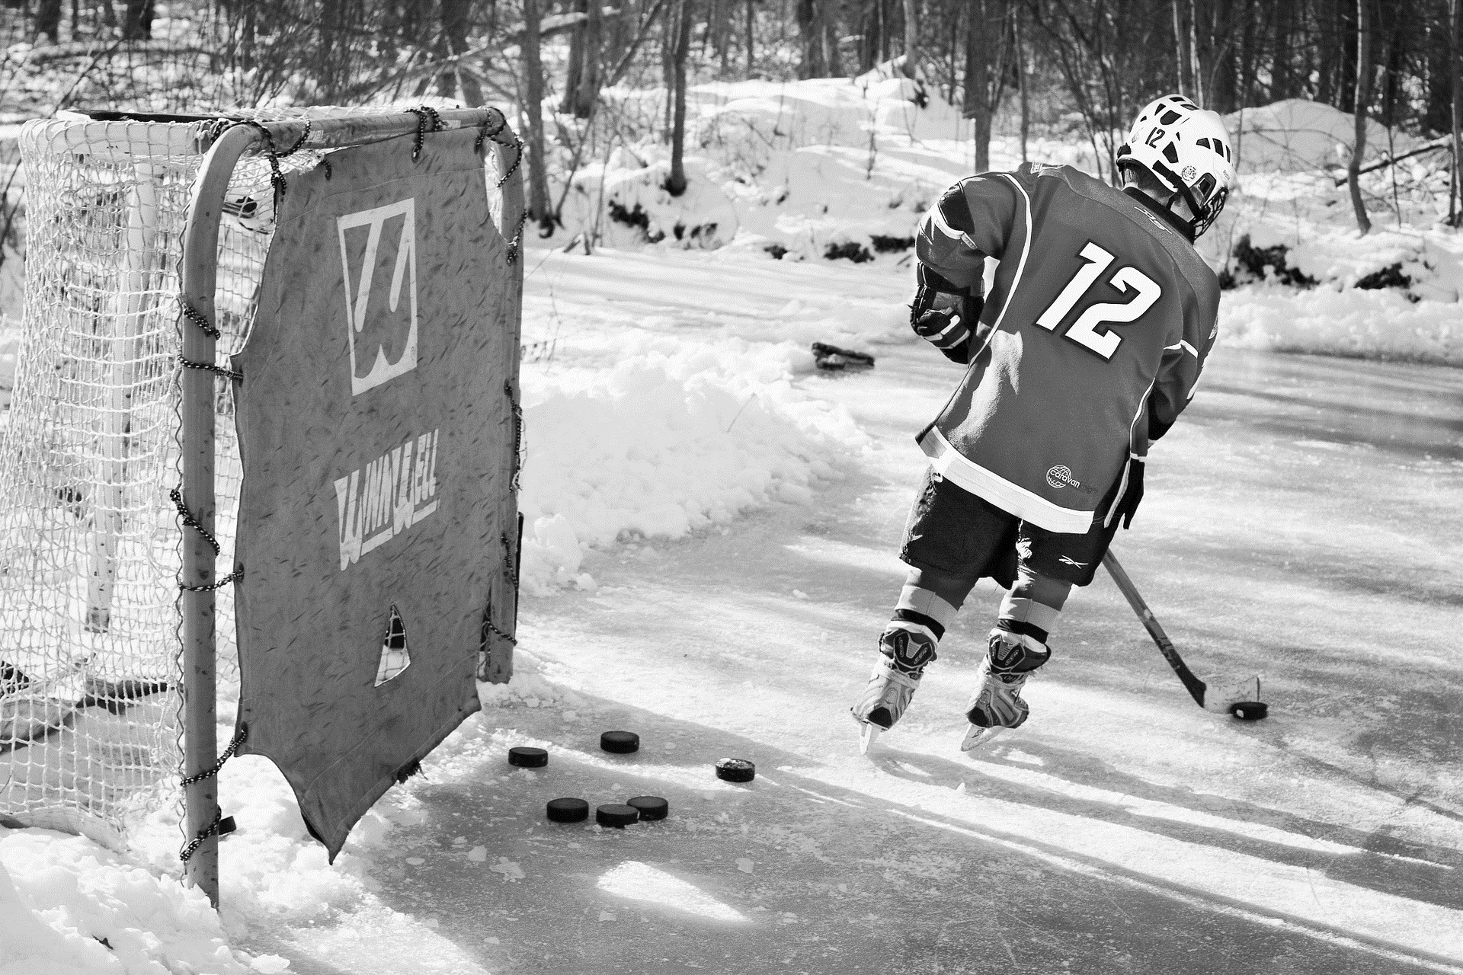
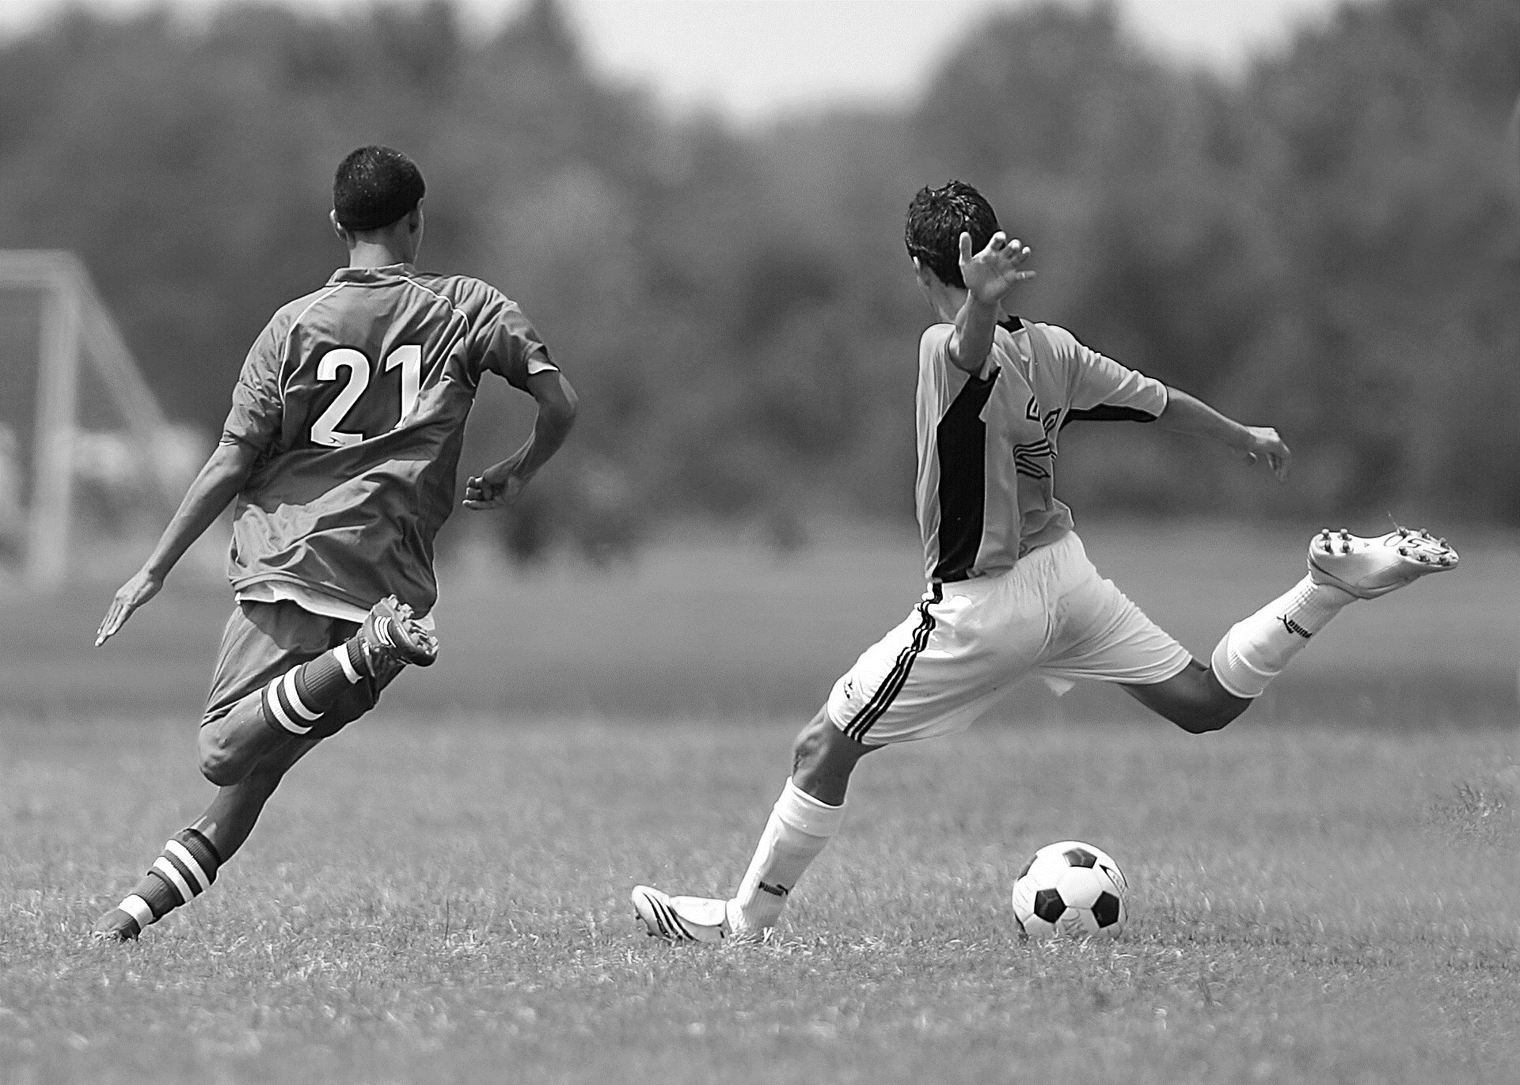
When he was six years-old he moved to Indonesia with his mother and step-father. His mother wanted him to go to school in the United States, so Barack moved back to Hawaii to live with his grandparents.
Barack liked sports and played on his high school basketball team. His jersey was number 23.
Two images do not belong. Delete them!
© 2021, Constitutional Rights Foundation and Los Angeles County Office of Education

Slide 5
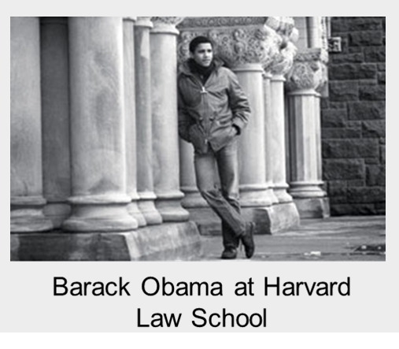
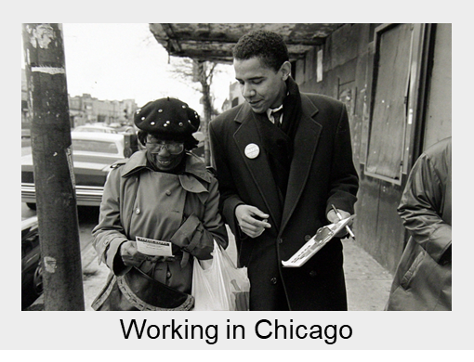
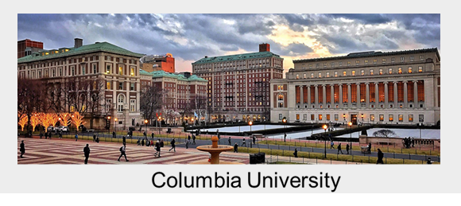
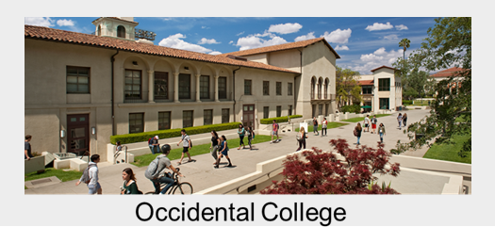
Barack had to work hard in school.
After he graduated from high school, he went to Occidental College in Los Angeles, then to Columbia University in New York City.
After he graduated from Columbia, he worked in Chicago to help people with housing and jobs. He decided he could help more if he had a law degree. He went to Harvard Law School.
1st
2nd
3rd
4th
One image does not belong. Delete it!
The photos are out of order. Move the photos to make a timeline.
© 2021, Constitutional Rights Foundation and Los Angeles County Office of Education

Slide 6
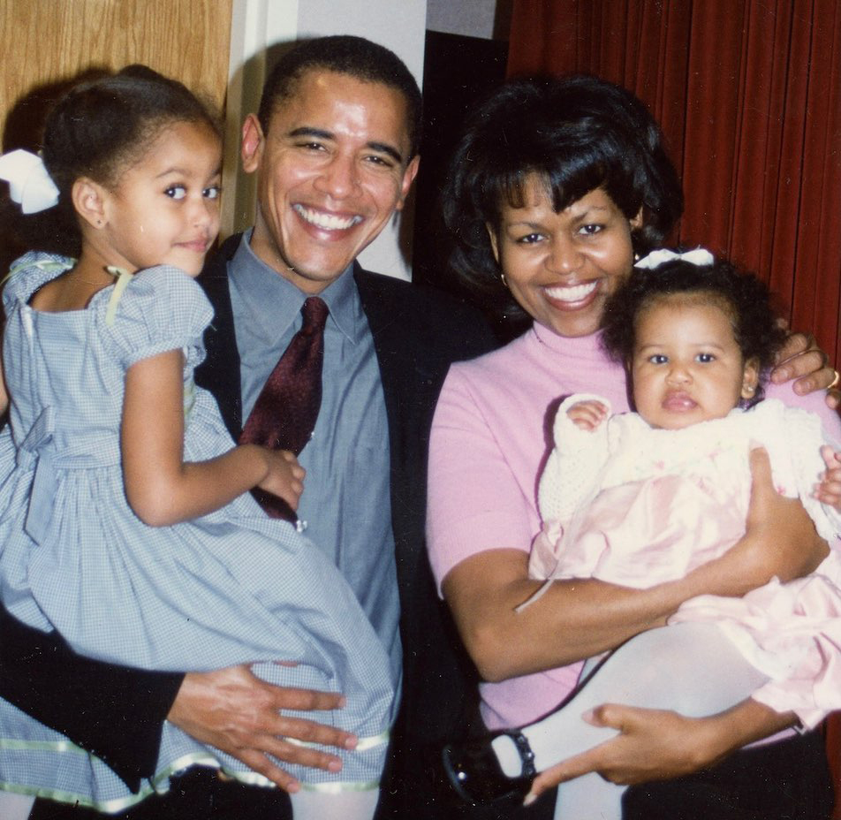
After law school, Barack moved back to Chicago. While he was working at a law office, he met Michelle Robinson and they got married.
Barack and Michelle Obama had two children. The older is Malia and the younger is Natasha (Sasha).
Family is very important to the Obamas.
Sasha Obama
Malia Obama
Label the children in the photo by moving their names into the boxes.
© 2021, Constitutional Rights Foundation and Los Angeles County Office of Education

Slide 7
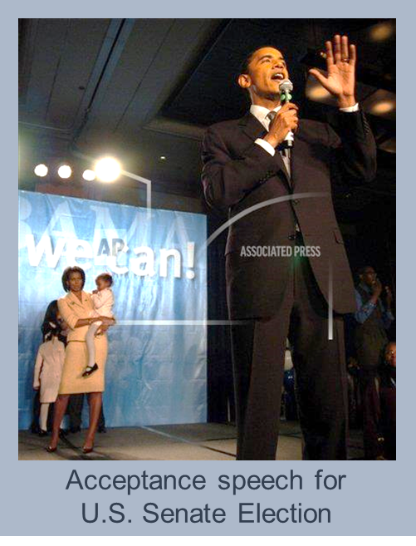
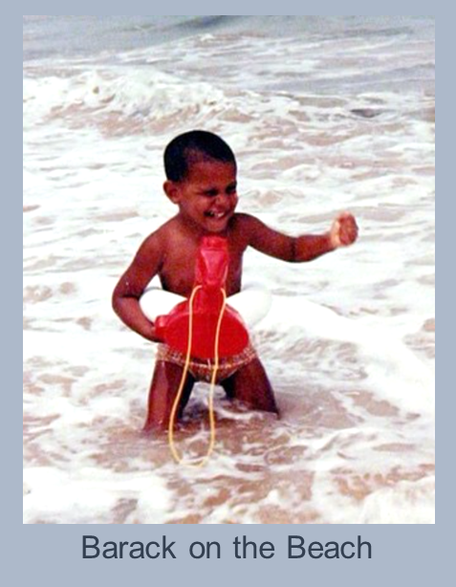
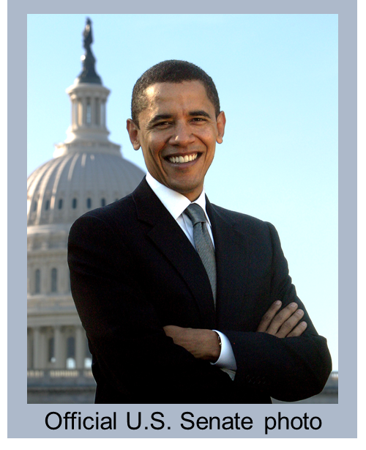
Barack Obama decided he could help even more people and make a bigger difference if he ran for office. First, he was a state senator in Illinois. Then, he ran for Congress in 2000. But he did not win.
He decided to try again, and he ran for the United States Senate to represent the whole state of Illinois. He won the election. Senator Obama was sworn into the United States Senate in 2005 and worked at the U.S. Capitol building in Washington, D.C.
One of the photos does not belong on this page. Delete it!
© 2021, Constitutional Rights Foundation and Los Angeles County Office of Education

Slide 8
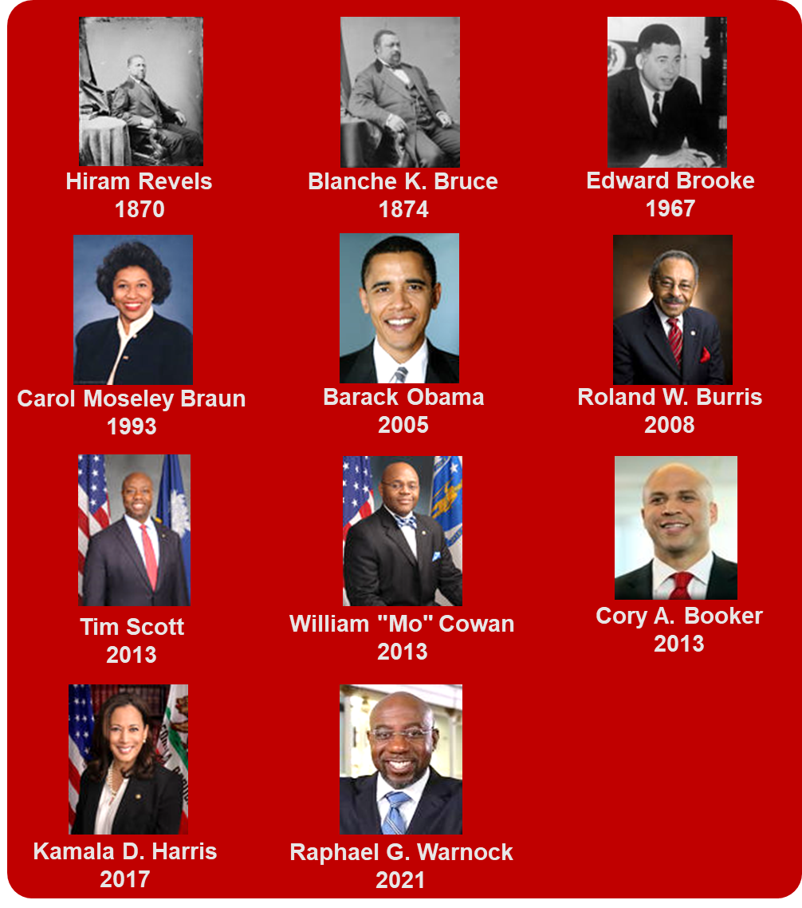
Black United States Senators
At the time, Senator Obama was the ____ Black person to be a U.S. senator in history.
1st
3rd
5th
There have been ___ Black U.S. senators since Obama was in the U.S. Senate.
2
6
4
Fill in the blanks.
Fill in the blanks.
© 2021, Constitutional Rights Foundation and Los Angeles County Office of Education

Slide 9
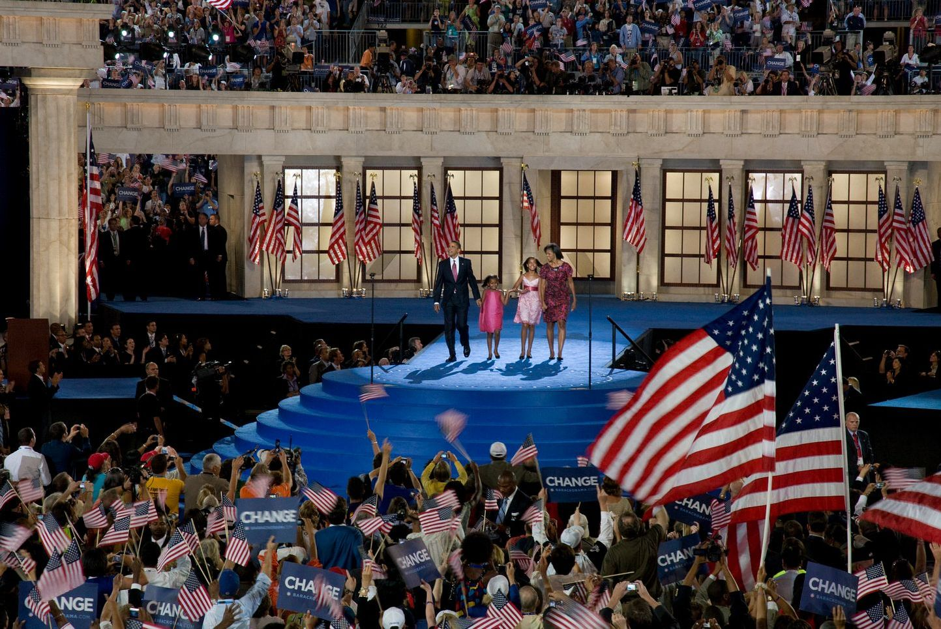
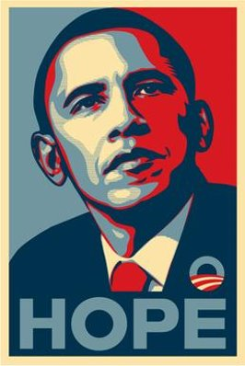
Malia started college at Harvard in 2017 and Sasha started college at University of Michigan in 2019.
During his campaign, Obama made speeches about hope and helping people who struggle.
One of Barack Obama’s favorite snacks is chips and guacamole, but the family tries to eat healthy foods most of the time.
In 2008 the Democrats chose Barack Obama as their candidate for president of the United States.
Choose the best captions for the photos and delete the other facts.
© 2021, Constitutional Rights Foundation and Los Angeles County Office of Education

Slide 10
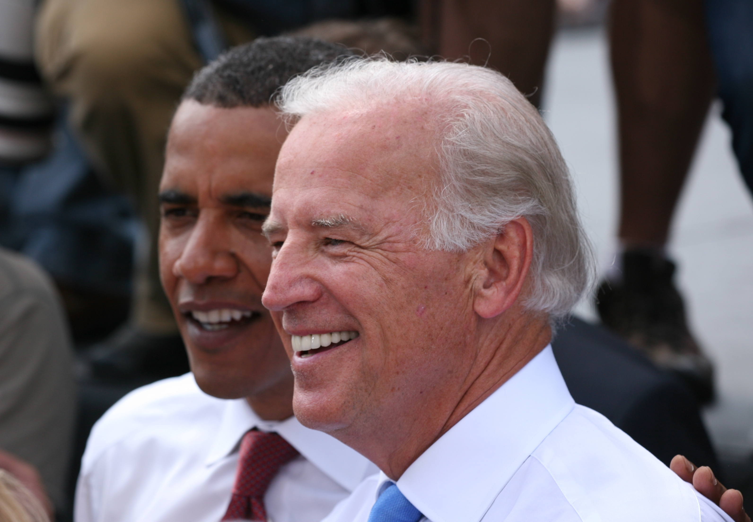
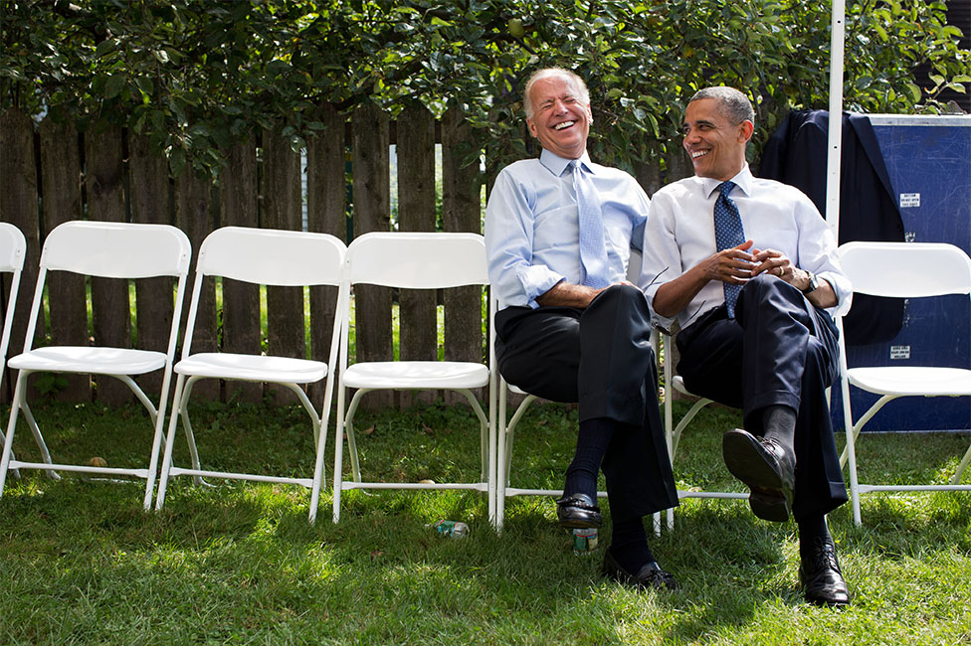
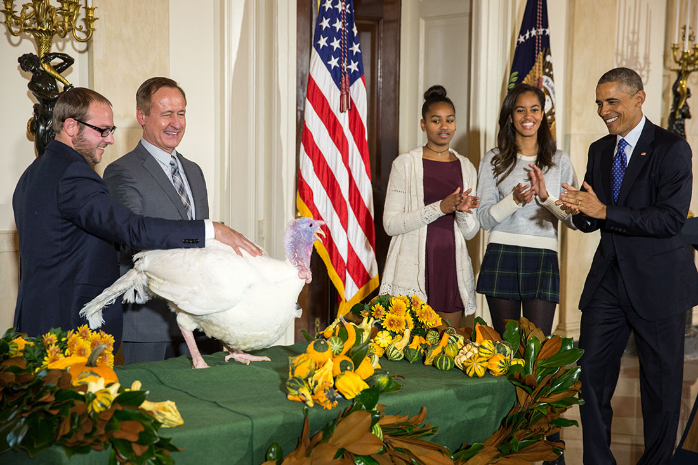
While he was running for president, Obama had to choose who he would want to be vice president. Obama chose Senator Joe Biden.
(In 2020, Joe Biden ran for and won the presidential election and became president on January 20, 2021.)
One of the photos does not belong on this page!
© 2021, Constitutional Rights Foundation and Los Angeles County Office of Education

Slide 11
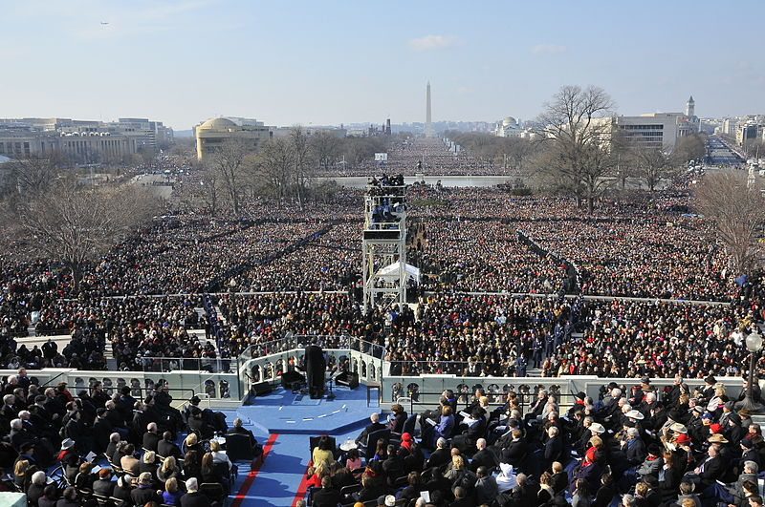
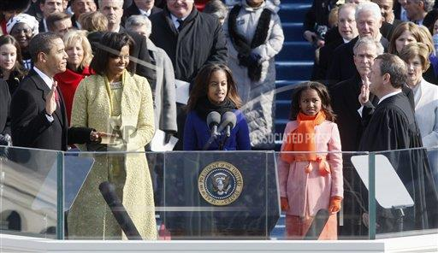
Barack Obama and Joe Biden won the 2008 election.
In the United States of America, new presidents are sworn in at an event called an inauguration. Barack Obama’s inauguration took place on January 20, 2009. At noon, he became the 44th U.S. president, and the first Black president of the United States.
President Obama is sworn in by Chief Justice Roberts.
Almost two million (1.8 million) people attended Barack Obama’s Inauguration.
Something is wrong on this page! Fix it.
© 2021, Constitutional Rights Foundation and Los Angeles County Office of Education

Slide 12
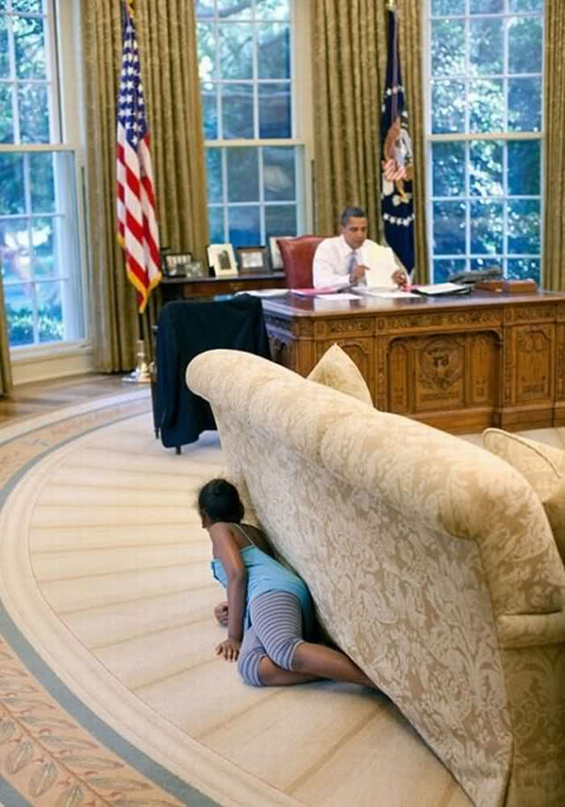
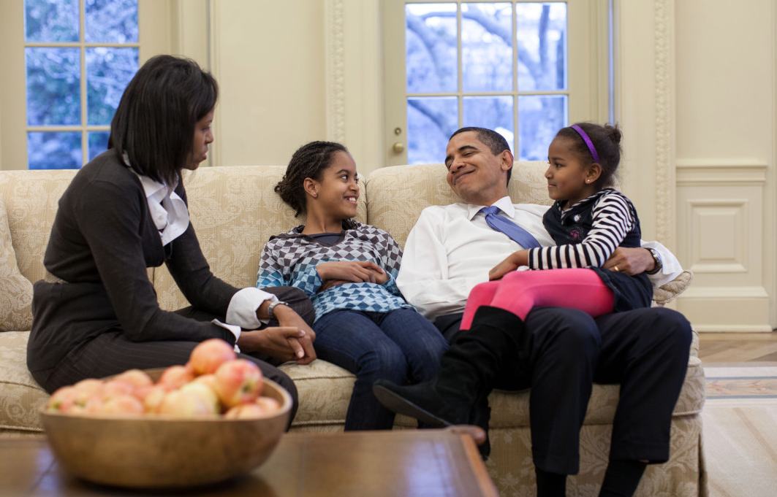
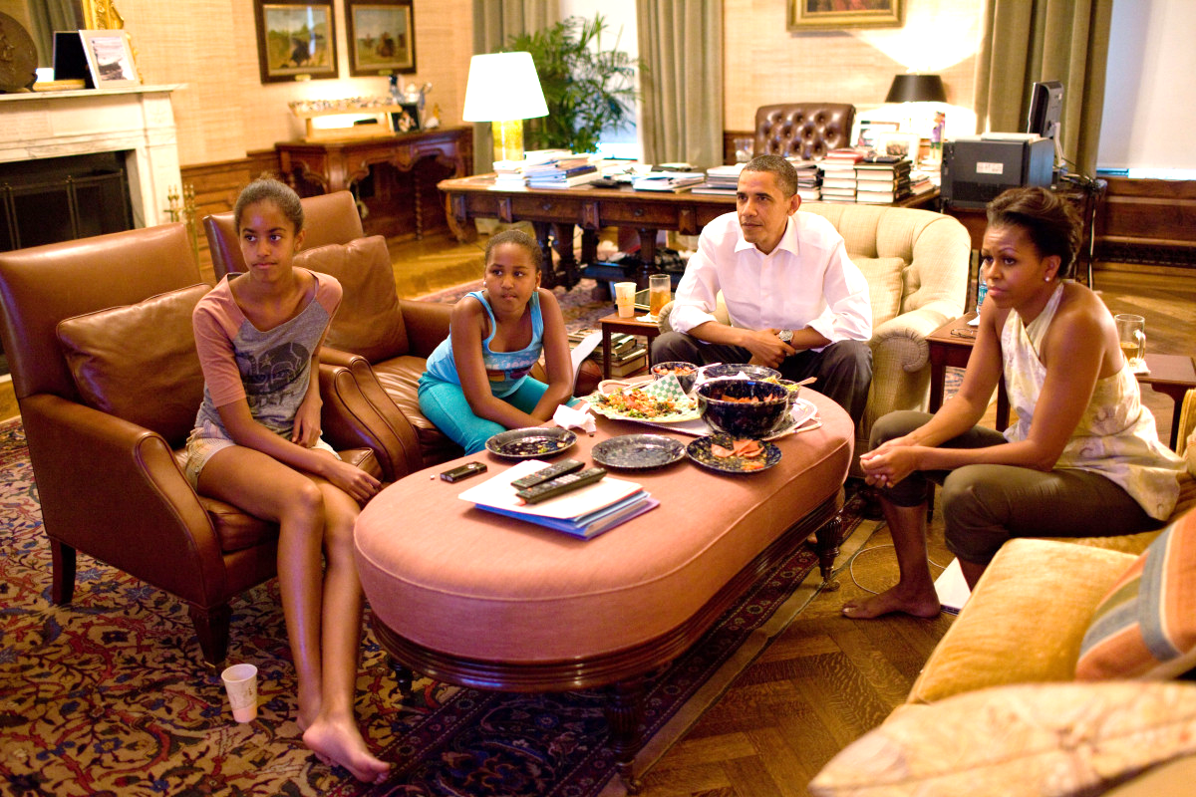
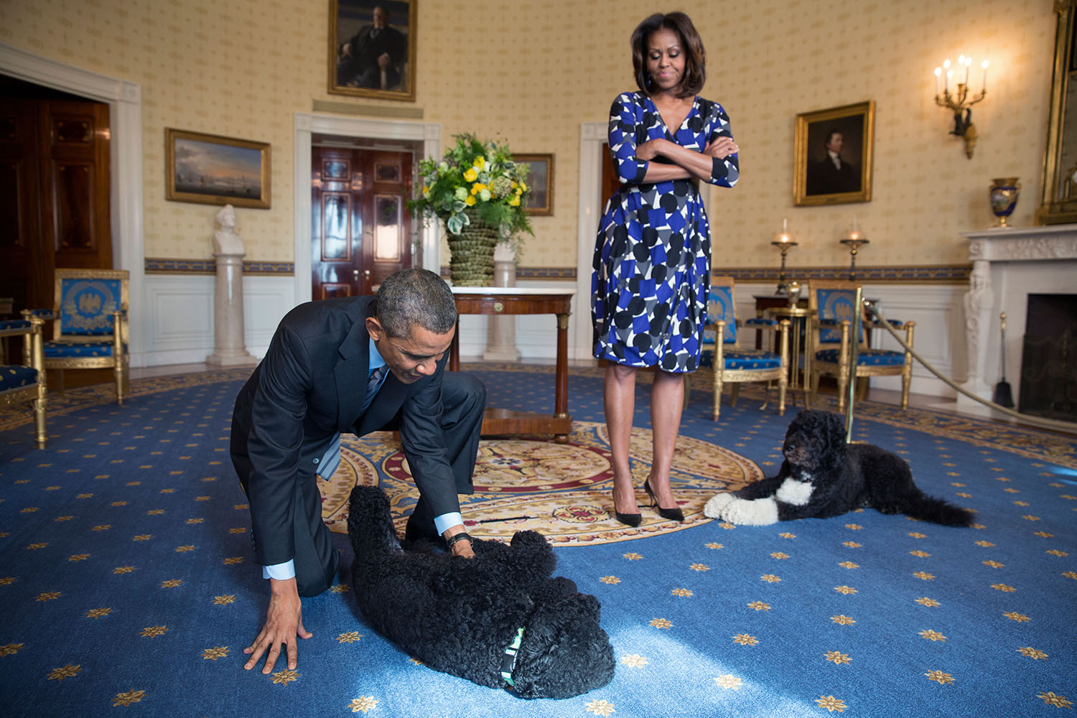
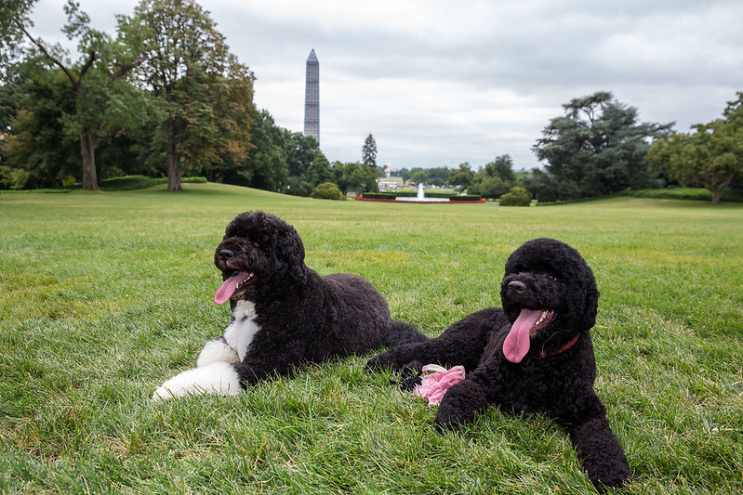
President Obama and his family lived in the White House in Washington, D.C.
President Obama promised Sasha and Malia that they could get a dog. They named their new dog Bo (white paws). Later, the Obamas got another dog and named her Sunny.
Choose your two favorite photos! Put the stars next to them.
© 2021, Constitutional Rights Foundation and Los Angeles County Office of Education

Slide 13
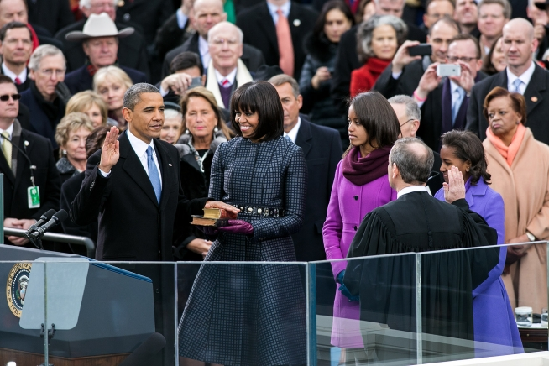
In the United States of America, presidents serve for four years, then they have to either run again or step down.
President Obama and Vice President Biden decided to run for a second term.
Obama and Biden won the 2012 election and were inaugurated on January 20, 2013.
Look carefully! Delete the 2009 Inauguration photo and keep the 2013 Inauguration photo.
© 2021, Constitutional Rights Foundation and Los Angeles County Office of Education

Slide 14
Why is it important to you that the United States elected its first African American president?
© 2021, Constitutional Rights Foundation and Los Angeles County Office of Education

Slide 15
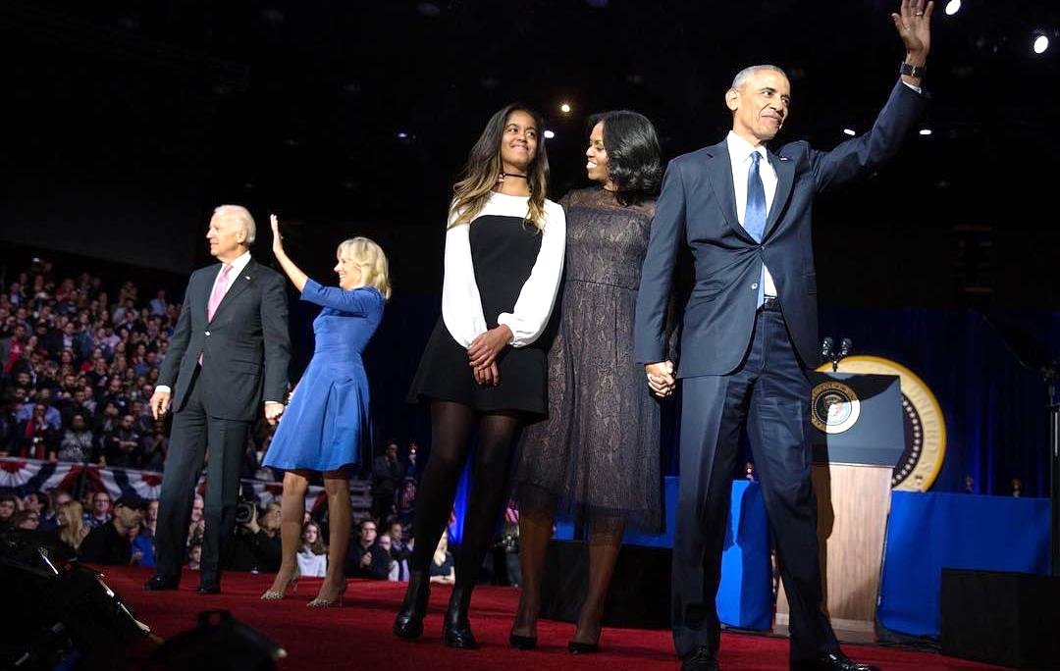
President Obama and First Lady Michelle Obama worked on many things like keeping people healthy, jobs, and the environment.
On January 10, 2017, President Obama made his farewell speech. Here is some of what he said:
My fellow Americans, it has been the honor of my life to serve you. I won't stop. In fact, I will be right there with you, as a citizen, for all my remaining days. But for now, whether you are young or whether you're young at heart, I do have one final ask of you as your president — the same thing I asked when you took a chance on me eight years ago. I'm asking you to believe. Not in my ability to bring about change — but in yours.
What do you think Obama meant by “Not in my ability to bring about change — but in yours”?

Slide 16

Just for fun…
Control + Click to see video!
Video: The Obama dogs say goodbye to the White House
https://www.youtube.com/watch?v=U6rKnETxS8c
© 2021, Constitutional Rights Foundation and Los Angeles County Office of Education

Slide 17
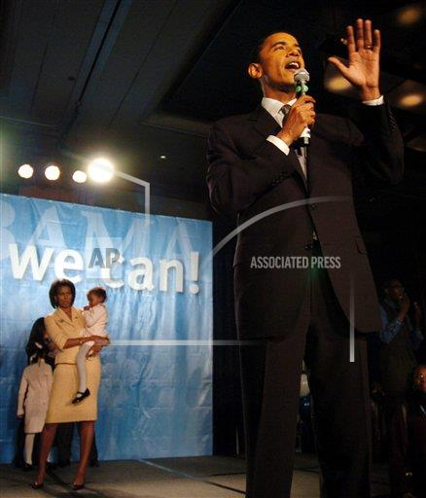
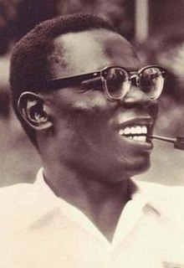
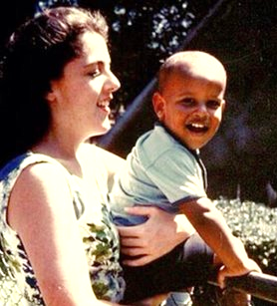
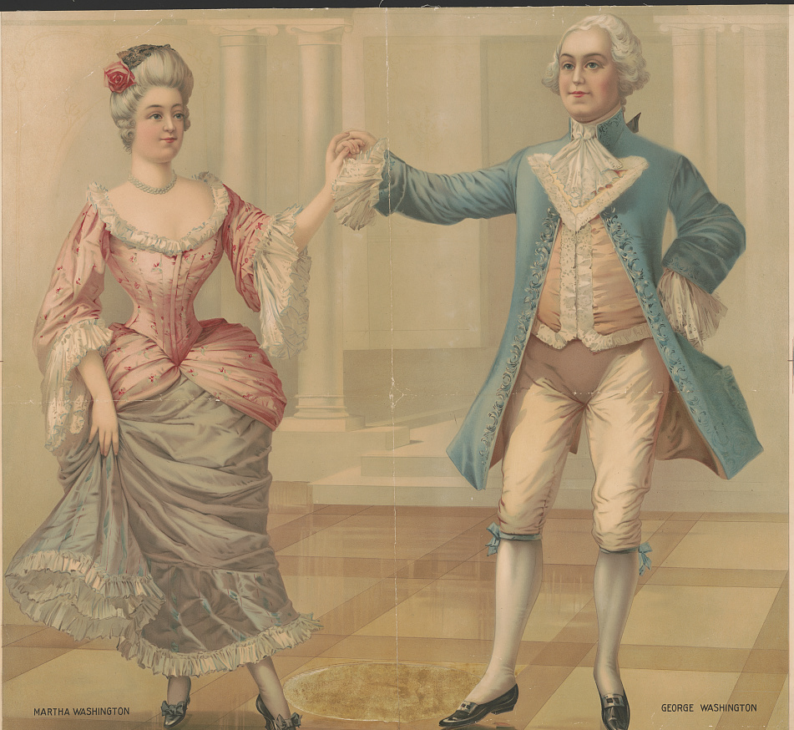
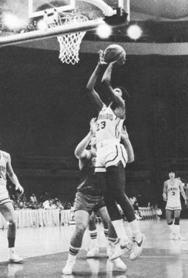
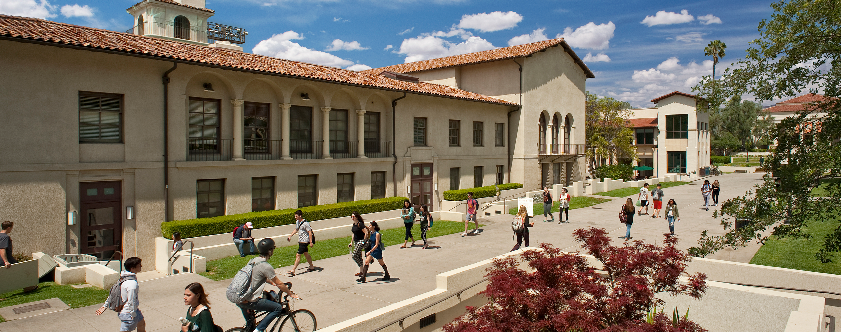
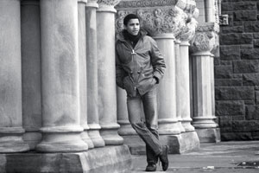
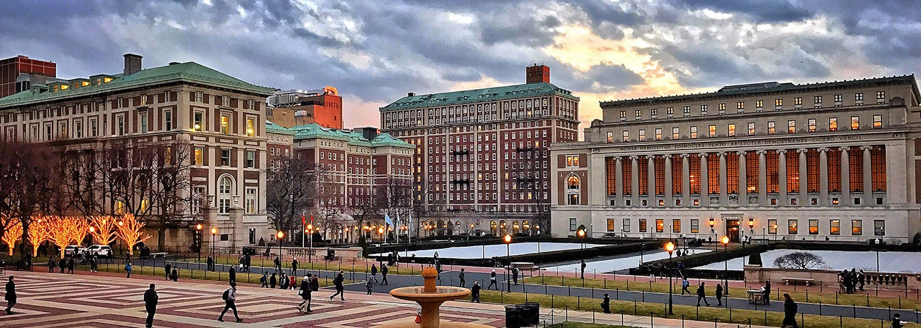
Photo Credits
Two of the photos are used with permission and licensed by Associated Press
http://www.apimages.com/metadata/Index/Obama-Inauguration/21c7d5b109734709ade4ffd67f969ff9/398/0 2009
http://www.apimages.com/metadata/Index/Associated-Press-Domestic-News-Illinois-United-/f31e07d8ace4da11af9f0014c2589dfb/2/0
Other photos were obtained from Obama White House website archives or social media accounts and are used courtesy of the Barack Obama Presidential Library, or were obtained from Wikimedia Commons or Pixabay. Senate photos were obtained the United States Senate website.
Occidental College website
White House archival files
Wikimedia Commons: https://en.wikipedia.org/wiki/Barack_Obama_Sr.
White House Archives:
https://obamawhitehouse.archives.gov/photos-and-video/photo/2012/05/stanley-ann-dunham
Library of Congress:
https://www.loc.gov/item/2018697445/
White House archival Instagram
Columbia University website

Slide 18
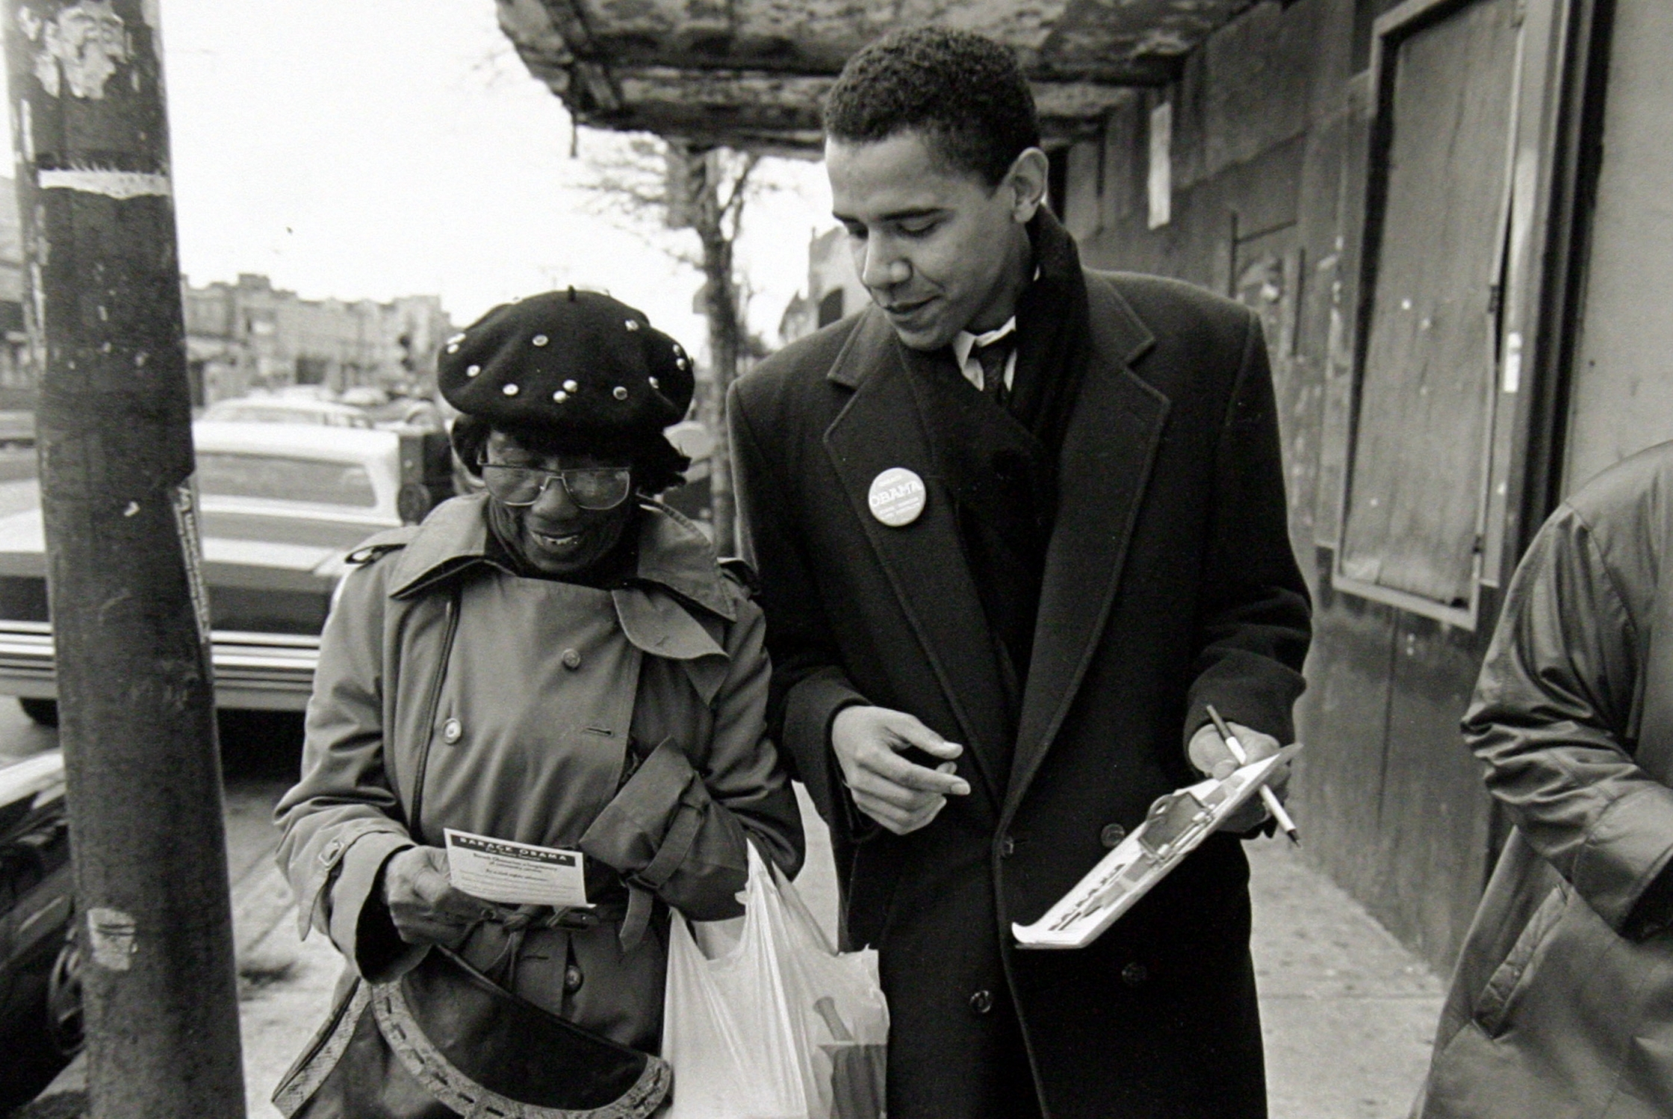
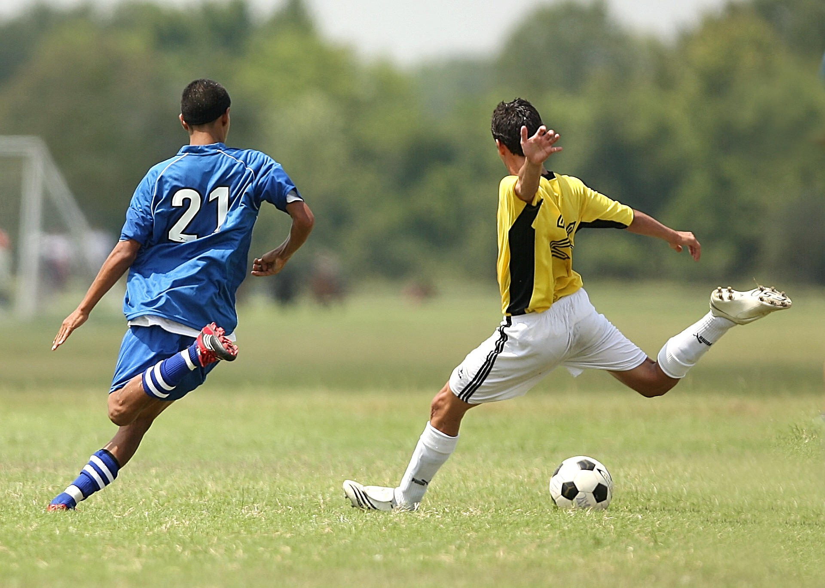
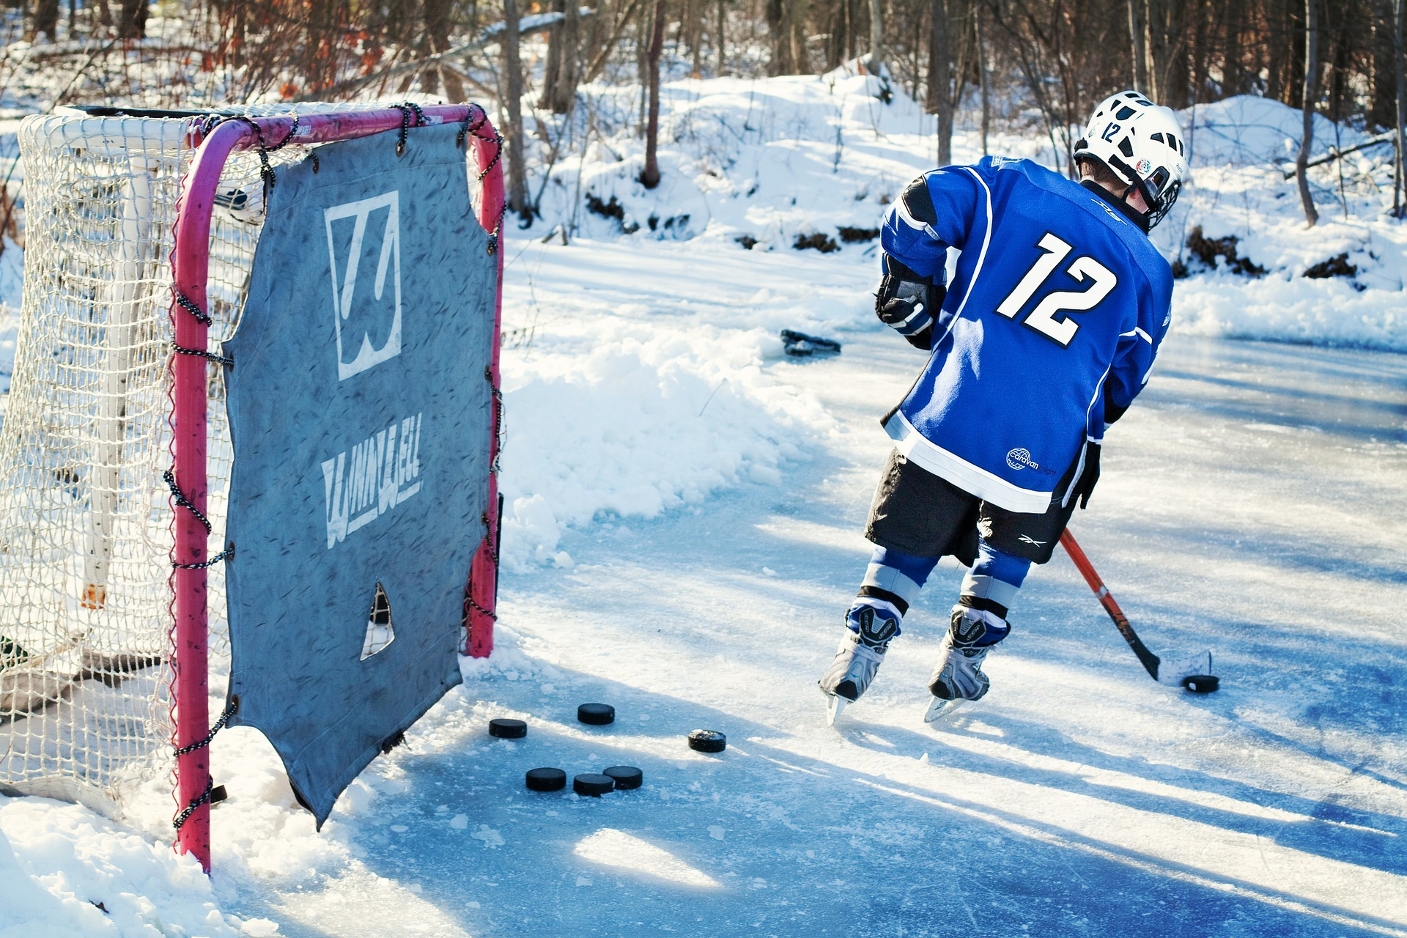

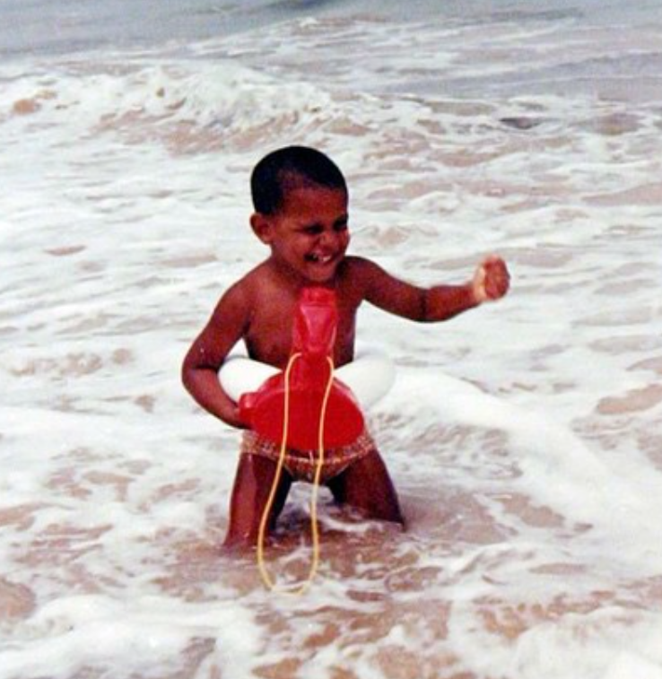
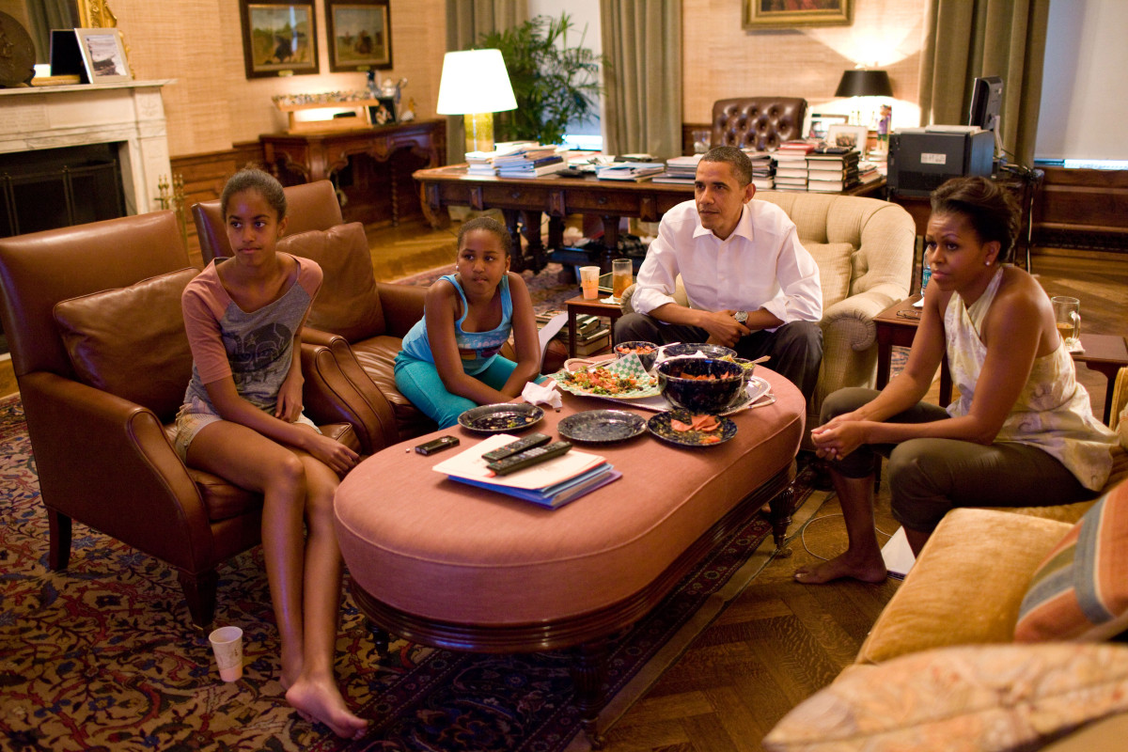
Wikimedia Commons: https://commons.wikimedia.org/wiki/File:Biden_Obama.jpg
Pixabay: Image by <a href="https://pixabay.com/users/keithjj-2328014/?utm_source=link-attribution&amp;utm_medium=referral&amp;utm_campaign=image&amp;utm_content=1457988">Keith Johnston</a> from <a href="https://pixabay.com/?utm_source=link-attribution&amp;utm_medium=referral&amp;utm_campaign=image&amp;utm_content=1457988">Pixabay</a>
Pixabay: Image by <a href="https://pixabay.com/users/jillwellington-334088/?utm_source=link-attribution&amp;utm_medium=referral&amp;utm_campaign=image&amp;utm_content=570892">Jill Wellington</a> from <a href="https://pixabay.com/?utm_source=link-attribution&amp;utm_medium=referral&amp;utm_campaign=image&amp;utm_content=570892">Pixabay</a>
White House archival files
Library of Congress: https://tile.loc.gov/image-services/iiif/service:pnp:highsm:03800:03848/full/pct:25/0/default.jpg
Wikimedia Commons: https://upload.wikimedia.org/wikipedia/commons/7/70/Sasha_Obama_plays_in_the_Oval_Office.jpg (Also White House archives)
White House: https://obamawhitehouse.archives.gov/blog/2014/11/26/president-obama-pardons-thanksgiving-turkey
Wikimedia Commons: https://commons.wikimedia.org/wiki/File:Obama_inaugural_address.jpg
U.S. Embassy: https://ca.usembassy.gov/president-obamas-farewell-address/
White House Photo
White House archival files
White House: https://www.obamalibrary.gov/photos-videos
White House: https://www.obamalibrary.gov/photos-videos
White House archival Instagram
White House archival files
White House archival files

