Slide 1
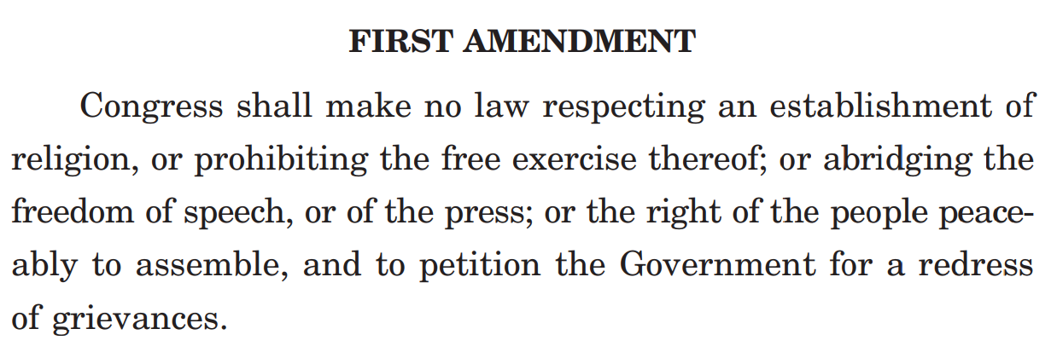

Slide 2
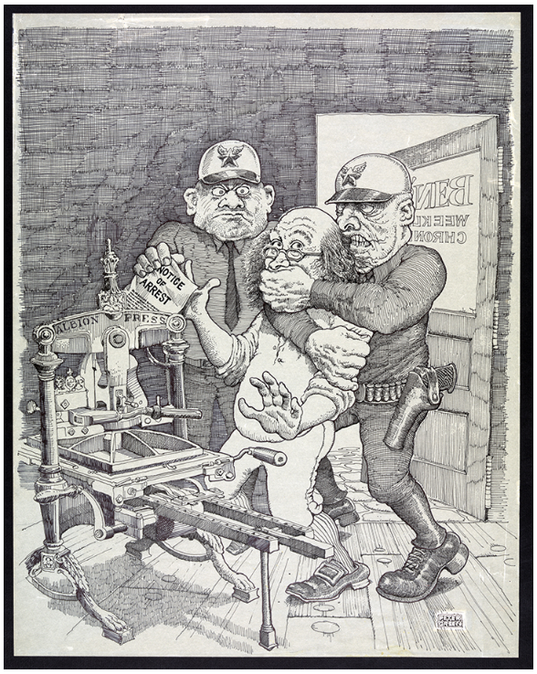

Slide 3
Peter Green. [Benjamin Franklin under arrest, ca. 1970–1977]. Ink and graphite drawing with printed overlay. Caroline and Erwin Swann Collection of Caricature and Cartoon, Prints and Photographs Division, Library of Congress.
Americans have long associated freedom of the press with American author, publisher, journalist and statesman Benjamin Franklin. Peter Green’s (b. 1945) satirical drawing in which two thug-like policemen apprehend Franklin in his print shop can be seen as a commentary on perceived authoritarian curbs on freedom of the press during the administration of President Richard M. Nixon.

Slide 4
1. Create your own poster on the importance of freedom of the press today. Draw on your discussion of the First Amendment, the Alien and Sedition Acts, and your everyday experience of the press.
2. Use images and symbols and include a message about freedom of the press on the poster.

